Slide 1

Software Test Automation for High Quality Software
VectorCAST Product Line Training

Slide 2






Company Overview
Industries
Aerospace
Automotive
Medical
Industrial
Railway
Business critical
Notes:
We offer services and solutions across a wide range of industries.

Slide 3




Company Overview
VectorCAST at a Glance
First product released in 1992 for Lockheed Martin’s C-130J Super Hercules
Integrated with 300+ compiler and target combinations
Solutions for: automotive, aerospace, medical, rail, industrial controls, and IoT
TÜV SÜD Certified: Software Tool for Safety Related Development
Acquired by Vector Group in 2017

Slide 4
Company Overview
How VectorCAST Helps Your Project
ALM
Requirements Gateway
Analysis
Metrics Reporting
Model-Based
Development
Parallel
Testing
VectorCAST
Continuous
Integration
Static
Analysis
System Test
Code Coverage
Unit Test
Compiler, Debugger,
RTOS, Simulator
Technical Debt
Legacy Testing
Notes:
If we identify all the VectorCAST features they break down into these functional areas.
These are the types of features you can add into your development and test process.
(Use this slide to click on any area the customer wants to learn more about.)
Unit Test
Eliminates the need to manually generate thousands of lines of test code to support low level software testing
Easy to build test cases for correctness assessment and defect tracking analysis
System Test
Automation of your existing high level tests
Impact of Change reporting and execution to determine what tests need to be rerun after a code change
Code Coverage
Assesses thoroughness of testing across the lifecycle
Satisfies all safety critical standards
Continuous Integration
Ensures regression errors aren’t introduced as code changes
Greatly speeds the time between code change and code test
Compiler, Debugger, RTOS, Simulator
Integrates with hundreds of compiler / chip combinations
Deep domain expertise by our engineers
Technical Debt, Legacy Testing
Using VectorCAST to baseline existing code behavior in order to ensure future code changes don’t alter behavior
Metrics for legacy code to identify software quality risk areas that need further testing
Static Analysis
Understanding how code meets coding standards like MISRA

Slide 5
Software Test Automation for High Quality Software
System Testing with VectorCAST QA

Slide 6
Lecture: System Testing with VectorCAST/QA
System Testing Overview
Where does VectorCAST/QA fit?
What is VectorCAST/QA?
Terminology
How the pieces fit together?
Steps to setup VectorCAST/QA

Slide 7
Lecture: System Testing with VectorCAST/QA
Where VectorCAST QA Fits into Your Development Process
Requirements Specification
System
Testing
Architecture
Integration Testing
VectorCAST/QA
System
Design
Unit
Testing
Coding
Notes:
The product portfolio has features and options that help you throughout your development process.
Continuous integration helps to make sure your product maintains high quality throughout development.
On the left side of the V, VectorCAST integrates with other tools you have in your development environment.
VectorCAST products reside on the bottom and right side of the V where testing takes place.
VectorCAST encourages a Correct, Complete Continuous approach to software testing.
Correct: Code correctness is the basis for high integrity (safety critical) software
Complete: Vector offers tools to support ALL your testing – not just your software testing. And it supports thoroughness of your testing.
Continuous: Testing should be done early and often and VectorCAST supports that through automation, dashboards, and integrations with tools like Jenkins.

Slide 8
Lecture: System Testing with VectorCAST/QA
What is VectorCAST/QA
Platform that’s comprised of two main functionalities:
Code Coverage (System Testing Environment)
C/C++ , ADA
Statement, Branch/Decision, MC/DC
Code-complexity analysis, Fault injection testing, Whitebox System Testing, Coverage by Analysis
System / Functional Test Verification
Automate the your existing tests to see what code is being executed
System tests can be executed different ways:
from scripts, manually through GUI, simulator,…
Change Based Testing (CBT)
VectorCAST/QA is not a system test creator
Other Vector product lines can create system tests such as CANoe, vTestStudio, etc.
Standards
DO-178 B/C (Avionics)
ISO-26262 (Automotive)
IEC-61508 (Industrial)
EN-50128 (Railway)
IEC-62304 (Medical)
Notes:
VectorCAST/QA does more than just Coverage. It also allows you run System Tests and use CBT analysis to intelligently run those Tests.
VectorCAST/Cover is used usually during system and functional testing
Cover is capturing the code coverage you have from your existing tests
You can share coverage data between all types of testing with VectorCAST
This sharing concept is important when doing requirements based testing, where you might run your high level requirements test first and later fill in the remaining coverage with unit test.

Slide 9
Lecture: System Testing with VectorCAST/QA
Terminology
System Testing | Testing methodology that’s applied to a Software Project (Drivers, Interfaces, Application, etc.). Tools to develop system tests are CANoe, vTestStudio, NI Test Stand, Python Scripts, debuggers, etc.
Preprocessor | Compiler mechanism to breakdown macros, header files, and tag for compilation
Translation Unit Parser | Output of the preprocessor (*.tu.c, *.tu.cpp) Commercial tool to parse through the TU
Instrumentation | Code added to your source code by VectorCAST to keep track of what statements and branches have been executed
System Testing Environment | VectorCAST environment that lists the source files to instrument for code coverage. Formally VectorCAST/Cover
VectorCAST/QA | VectorCAST platform that consists of a System Testing Environment and the automation of System Test Verification with code coverage
Notes:
Just go through these, the definitions build on each other.

Slide 10
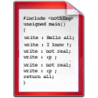

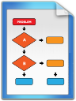

Lecture: System Testing with VectorCAST/QA
How the pieces fit together
VectorCAST/QA
VectorCAST
Source
Instrumented Source
Instrumented binary application
Preprocess
Parse
Instrument
Compile
System Testing Environment
Automate
Load/Flash
Collect Coverage
Target
System Test
Reports
Coverage Data
Coverage data via UART, File, CAN, debugger, etc. and log to file on host

Slide 11
Lecture: System Testing with VectorCAST/QA
Steps to setup VectorCAST/QA
Collect a build log of the source code application
Create a VectorCAST System Testing Environment and choose a template that matches the source code’s compiler
Use the build log to adjust VectorCAST Options
Select the source code to add for code coverage
Instrument the source code
Adjust the target’s I/O mechanism for VectorCAST’s coverage output API (c_cover_io.c/c_cover_io.cpp)
Compile the instrumented source code along with c_cover_io (*)
Flash the instrumented binary onto the target (*)
Execute the system test using system testing procedures (CANoe, vTestStudio, scripts, etc.) (*)
Collect coverage by calling VectorCAST’s coverage output API and log the contents to a .DAT file (*)
Import the .DAT file into VectorCAST System Testing Enviornment
Create regression scripts
Save regression scripts and other support files into configuration management
(*): Points of automation based on third-party capabilities

Slide 12
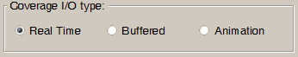
Lecture: Code Coverage Options
I/O Mechanisms
Coverage Tab Option:
Controls amount and frequency of data dump to host
Real Time – coverage output interlaced with test execution
Might slow test execution, but not usually important for Unit Test
Buffered - coverage data output at end of test
Might lose coverage data if test aborts
Animation – allows single-step through coverage results
Every instrumentation line dumps data (there will be duplicates)
Allows post run analysis of the control flow
Changing I/O Mode requires re-instrumentation of environment
Notes:
Code Coverage Mechanics
Regardless of I/O mechanism, a bit array is used in memory to collect coverage info
Real-Time – first time statement/branch is hit, data is output and flag is set; when flag is set, no output necessary
Buffered – whenever statement/branch is hit, flag is set; when harness is complete, all ‘set’ flags are output
Animation – no flags; output every time statement/branch is hit (used for Coverage Animation)

Slide 13
Lecture: System Testing with VectorCAST/QA
Coverage I/O Files
VectorCAST Cover I/O files
The I/O files are in the environment directory and are called:
c_cover_io.c for C source files
c_cover_io.cpp for C++ source files
vcast_c_options.h, c_cover.h included by the above
vcast_cover_io.adb, for Ada source files
vcast_cover_io.ads
I/O files contain the Data Structures & Functions needed to record the Coverage Information
When compiling/linking the instrumented source files, you must include the appropriate I/O file (for “c”, e.g., link in c_cover_io.c)
Add to your compile command: gcc -g -c manager_driver.c manager.c database.c %COVER_ENV%/c_cover_io.c
Append through the GUI
IMPORTANT: Note that you may need to customize the I/O files to support the particular I/O mode and I/O API that exists on your target.

Slide 14
Lecture: System Testing with VectorCAST/QA
Building an Instrumented Executable
Two Methods
Use Normal Build Mechanism to build your application
e.g,, makefile, Visual Studio Project, Eclipse Project. etc…
Add c_cover_io.c to your project
Add the include path for vcast_c_options.h & c_cover.h
Note that vcast_c_options.h changes if instrumentation options change.
Use the System Test Script in VectorCAST
RightMouse on Environment -> SystemTesting->EditScript
Add Build Command to Python Script
Optionally, add Execution Scripts

Slide 15
Lecture: System Testing with VectorCAST/QA
Collecting Coverage Results
Once the Executable is Built:
Running the code will execute the Instrumented Code
Code Coverage Results will be stored in TESTINSS.DAT
File is overwritten at each execution
Coverage Results are Imported Into VectorCAST cover
ENVIRONMENT => ADD TEST RESULT
Point to TESTINSS.DAT
Give descriptive name to the results
Results are listed in Test Results Pane
Checking box indicates coverage for test situation should be displayed
Double-click on source file to bring up Coverage Viewer

Slide 16
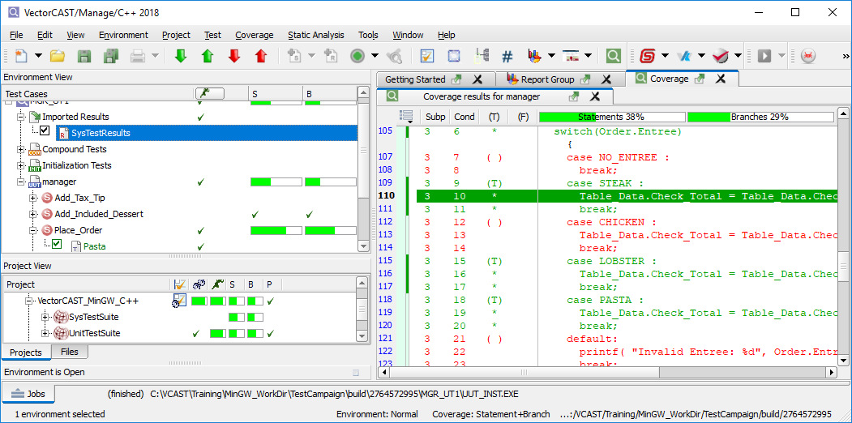
Lecture: System Testing with VectorCAST/QA
Integrating Coverage between System & Unit Testing
System & Unit Coverage can be combined in one view

Slide 17
Lecture: Regression Testing
Regression Testing Topics
What is Regression Testing?
Why is Regression Testing Important?
How does VectorCAST support Regression Testing?
What Files Need to be Configuration Managed?
Introduction to the VectorCAST Command Line
Creating regression Scripts
Using Regression Scripts
Test Scripting Overview
Hand Editing a Test Script
Strict Test Script Importing
Notes:
Don’t explain each of these … there are following slides for this, just
Go through the list and say:
In this module we are going to learn some of the basics of …
We’ll show you how to …

Slide 18
Lecture: Regression Testing
What is Regression Testing?
Regression Testing is taking existing tests and running them against new versions of the application software
Re-Use of Tests is the goal
All types of tests can be used as Regression Tests
System Tests
Functional Tests
Stress Tests
Integration Tests
Unit Tests

Slide 19
Lecture: Regression Testing
Why is Regression Testing Important?
Testing once makes no sense
Testing constantly improves quality
Bugs are easiest to fix on the day that they are introduced
Code can be re-factored over time
Test cases are kept in sync with code
Notes:
If you don’t leverage the time and money spent on testing, you are wasting time and money
You _WILL_ introduce bugs when you change your application, no doubt!
Finite number of patches to be reviewed
Conversely months later it may take days to find the source of the bug
The biggest reason that engineers don’t re-factor code is the lack of adequate test cases
Re-factoring code is risky – I might break something!
Robust test infrastructure means code can be re-factored with confidence
Minimal maintenance required if tests are constantly maintained
Huge effort if tests are updated only at release time

Slide 20
Lecture: Regression Testing
How does VectorCAST facilitate Regression Testing?
Test Harness is Data Driven
Test Cases are persistent as design and code mature
Test Harnesses can be rebuilt automatically
Batch execution of tests
Expected results checked with each run
Pass/fail criteria is maintained
Command Line Scripting Interface
CLICAST- for Individual Environments
MANAGE– for VectorCAST Projects
VCDASH – for Controlling Analytics Database Server
Notes:
This means that you are not changing test code when the application changes
Because of this decoupling of the test data from the test harness, there
Is very little maintenance of the tests needed to re-use them as the code changes
If you have the same version of the tool, the same tests, and the same source code
You can ALWAYS re-run the same test, even 10 years from now.

Slide 21
Lecture: Regression Testing
Change Based Testing (CBT)
CBT – Intelligent Testing
Only those Environments that have changed will be Rebuilt
Source Code or Config Changes
Only those Tests that are affected by a change will be executed
Granularity is down to the function level
Analogous to “Make” vs “Make all”

Slide 22
Lecture: Regression Testing
VectorCAST Command Line Utilities
Enables further automation of testing via shell scripts
3 Different Scripting Engines:
CLICAST – for Individual Environments
MANAGE for VectorCAST Projects
VCDASH – for Analytics Database Server
All Commands are self documenting
Just enter the commands with no arguments to get help
Notes:
clicast is the name of the executable for the command line tool
It is located in the normal installation directory %VECTORCAST_DIR% $VECTORCAST_DIR
Commands are context sensitive …
If you provide only a “–u unit” argument, and then say, “execute run” clicast will run all tests for the enviro.
If you also provide a “-s subprogram” argument then “execute run” clicast will run all tests for that sub-program

Slide 23
Lecture: Regression Testing
Command Line Examples
Rebuild an Environment:
clicast -e mgr_ut1 Environment RE_Build
Execute all Tests in an Environment:
clicast -e mgr_ut1 Execute Batch
Build & Execute all Tests in a VectorCAST Project
manage --project TestCampaign --build-execute
Incrementally Build & Execute all Tests in a VectorCAST Project
manage --project TestCampaign --build-execute --incremental
Generate a Full Report
manage --project TestCampaign --full-status=full_report.html
Start the Analytics Database Server
Vcdash --run-server --save-history -p TestCampaign.vcm
Notes:
CAPs in the commands show the minimum string need to make the command unique.
Each time you type a command it will show you either a single command help or the next category
For example, “help execute” will show all of the possible “execute” commands.
“help execute run” will show you the description of that single command.

Slide 24
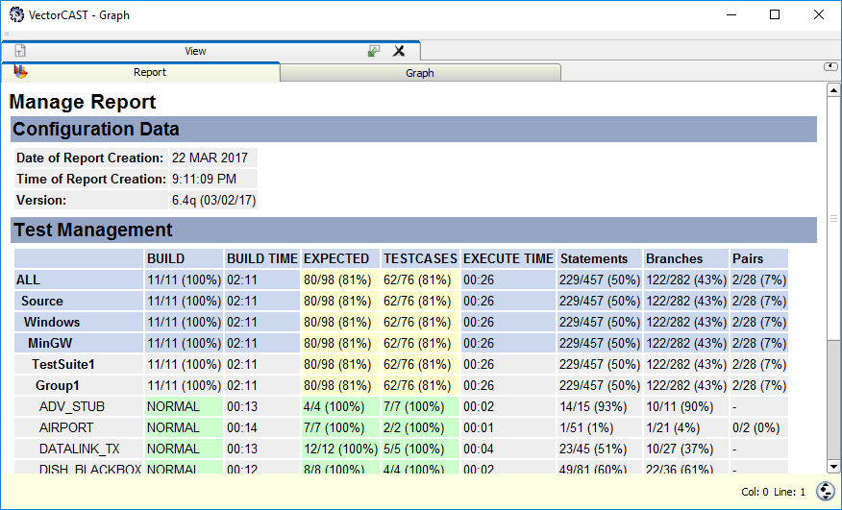
Lecture: Regression Testing
Regression Results
Right Mouse -> Reporting

Slide 25

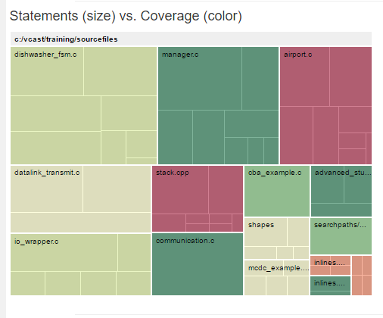
Lecture: Regression Testing
Analytics
Graphical View of Testing Results
Analytics Icon:
Notes:
Colored heat map indicates areas of most concern. In this view, the size of the box indicates the size of the module (# of Statements) whereas the color indicates Code Coverage. Green is good, Red is bad.

Slide 26
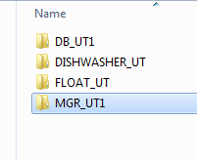
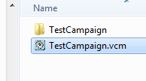
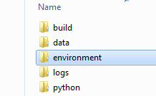
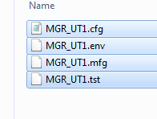
Lecture: Regression Testing
Saving Your Work
3 Things to Save
The VectorCAST Project File (*.vcm)
The Directory Structure
Entire contents of the Environment Directory (1 Subdirectory per Environment)
All other files can be generated
Notes:
Changing values and importing is a common use

Slide 27
Lecture: Code Coverage Basics
Coverage By Analysis (CBA)
Allows Users to Augment the Coverage Metrics
Notes can be added to explain the Augmentation
Handles cases where code is hard to reach, or impossible to reach
CBA Coverage is reported on a separate line item from standard coverage
Can be aggregated to show 100% coverage where normally that would not be possible.
Notes:
CBA, in general, allows you to get coverage on code that is either impossible or difficult to execute through a test case.
Before CBA, you would have to document this process externally from the tool. Now, CBA brings this into VectorCAST.

Slide 28
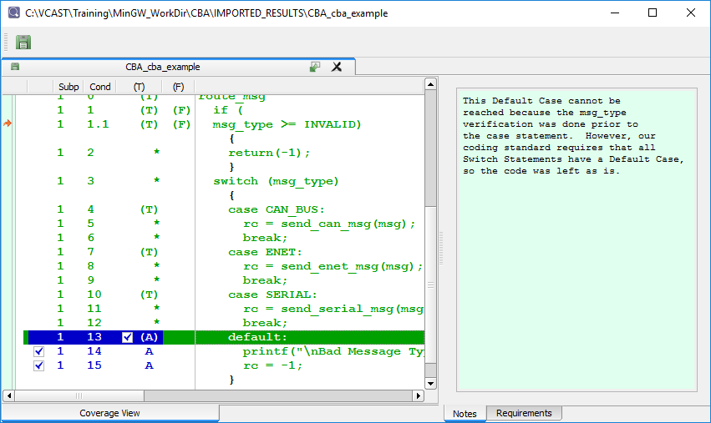
Lecture: Code Coverage Basics
CBA Screenshot
Note CBA lines selected in Blue and corresponding notes

Slide 29
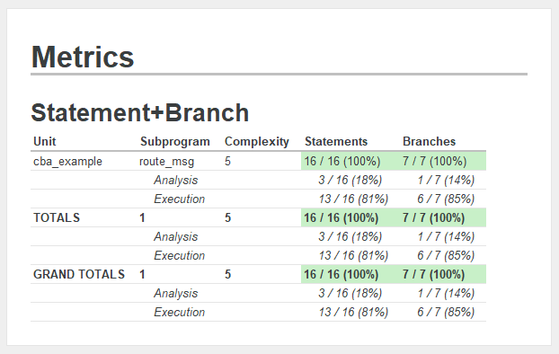
Lecture: Code Coverage Basics
CBA Report
“Analysis” line shows CBA Metrics

Slide 30
Lecture: Probe Points
Probe Points Overview
Allows modification of the code under test, without actually changing the source code
Similar to a patching mechanism
Can be used in Unit Testing, as well as System Testing with QA.
Requirements:
Code Coverage Needs to be enabled
Probe Points need to be compiled into the Test Harness, similar to Environment User Code
For Printed Output, Enable “Redirect Standard Output” (Tools->Options->Execute)
Caveats:
Documentation may be required for certification purposes
Buyer beware! Probe Points are very powerful, but can also be dangerous if written incorrectly
Notes:
Caveats:
Since Probe Points modify the Unit Under Test, extra documentation may be required to explain the usage of Probe Points to a Certification Body.
2) Here’s an example of the “Buyer Beware!” point. If the original code looks like this:
If (x)
y = 0;
And you insert a probe point after the 2nd line, should it be included as part of the “if” clause or not?

Slide 31
Lecture: Probe Points
Probe Point Applications
Common Uses
Capturing/displaying local variables during execution
Injecting spurious errors to test error handling code
Patching faulty code to test a fix prior to committing the change
Grey Box Testing
Access to code that is normally hidden, even in White-Box Testing
Can be used in Unit, Integration, and System Testing

Slide 32
Lecture: Probe Points
Built-In Utilities
vcast_probe_print(char *)
Print an ASCII String
vcast_probe_assert(char *, boolean)
Adds a Pass/Fail status depending on the value of the boolean
vcast_probe_print_int(int)
Print an Integer
vcast_probe_print_unsigned(unsigned int)
Print an Unsigned Integer
vcast_probe_print_float(float)
Print a Float
vcast_test_name_equals(char *)
Allows for Test Case Specific Code

Slide 33
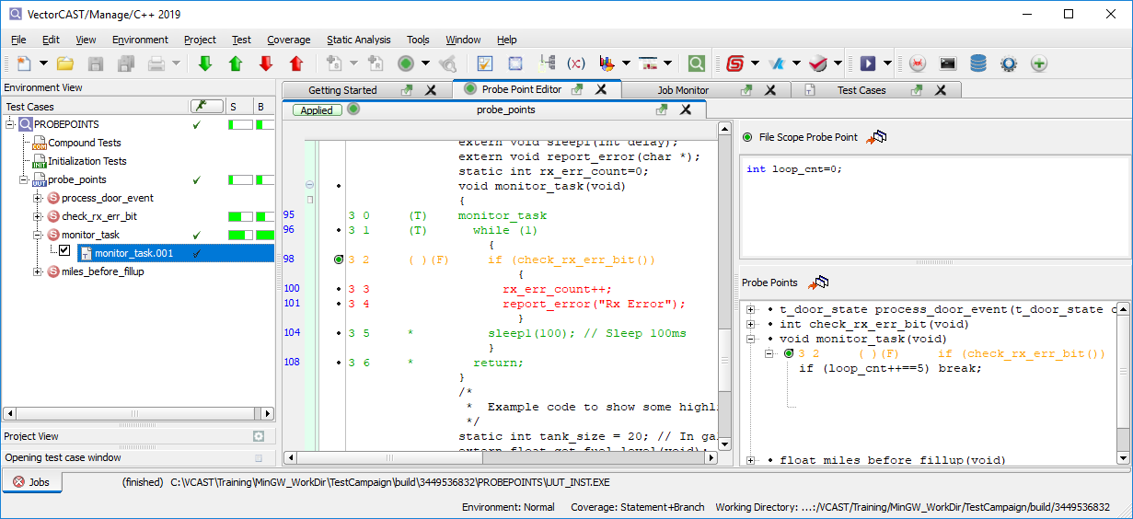
Lecture: Probe Points
Probe Point Screenshot
Notes:
In this example, the Probe Point breaks out of the infinite loop after 5 iterations.
Note the usage of a File Scope (global) variable to count the iterations.

Slide 34
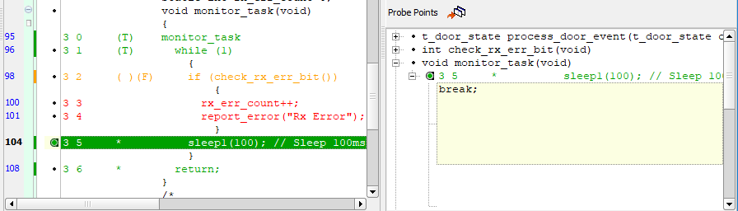
Lecture: Probe Points
Screenshot Detail
Probe Point used to break out of infinite loop
Original code on the left
Probe Point on right, before call to “sleep()”
Probe Point Identified by Function/Statement number (i.e. “3 5”)
Probe Point View also shows Code Coverage

Slide 35

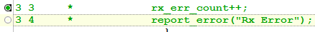
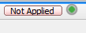
Lecture: Probe Points
Probe Point Icons
Probe Point Window is launched from Toolbar:
Probe Points can be individually Activated/Deactivated by clicking on Green Circle:
Probe Points are built into the Test Harness by selecting button in upper left corner

Slide 36
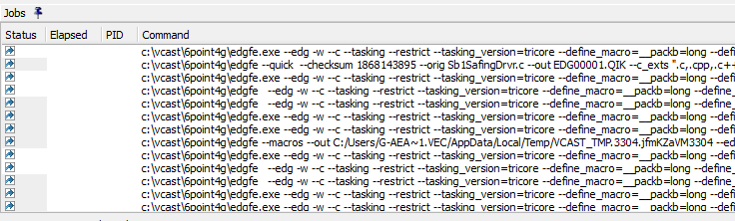
Lecture: Trouble Shooting the Build Process
The Jobs Window
The Jobs Window shows the exact commands that VectorCAST runs at the shell
Find the Jobs tab at the bottom left of the GUI and pin it open
Double click on the last line to get the detailed command line and its output in a larger window

Slide 37
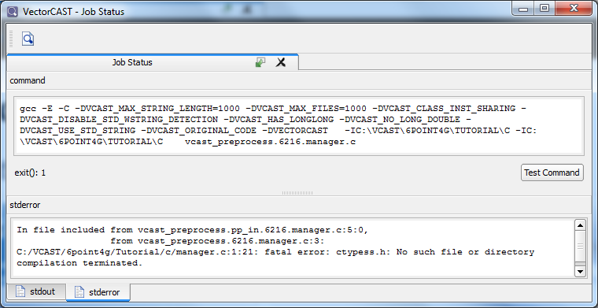
Lecture: Trouble Shooting the Build Process
The Jobs Status Window
The Jobs Status Window appears when you double click on a line in the Jobs Window
You should see the exact command line and it’s output
Notes:
In this case, an include file could not be found

Slide 38
Lecture: Trouble Shooting the Build Process
Running Commands Outside of VectorCAST
If the Log Messages or the Jobs Window doesn’t narrow down the problem, sometimes it helps to run the command outside of VectorCAST.
DoubleClick on the last line of the Jobs Window
Copy the contents of the Job Status Command Window
Open a shell (DOS window) from VectorCAST
Find the DOS Window Icon, or do Tools->CustomTools->CommandPrompt
Paste the command and run it there
This should be identical to what is shown in the Job Status Window, but sometimes it helps to eliminate the VectorCAST GUI and see things at the command line.

Slide 39
Lecture: Target Testing Concepts
Target Testing Topics
What is a VectorCAST/RSP?
Options that affect Test Harness Construction
Configuring Test Harness I/O
Configuring Target Test Execution
Notes:
Don’t explain each of these … there are following slides for this, just
Go through the list and say:
In this module we are going to learn some of the basics of …
We’ll show you how to …

Slide 40
Lecture: Target Testing Concepts
Run-Time Support Package (RSP)
RSP = Run-Time Support Package
Provides abstraction for interface between VectorCAST and the Test Harness
Allows the core VectorCAST functionality to be compiler and target neutral
RSP Considerations
Language Extensions
Linking (Startup Code, RTOS, Stack, Heap)
Download
Results Capture
Info needed for Building new RSPs
EXACT version of the compiler
Identification of MINIMAL startup code
How can I run a “hello world” program on your target?
Notes:
RSP is a combination of configuration options that enable test to be built and run
For a particular compiler / RTOS / and Target Configuration
There are lots of different combinations that we support, but in general
All of the combinations require some sort of modification of the listed components
Language Extensions:
Things beyond the normal language spec
A lot of cross compilers support linker attributes in the source code, pragmas etc
Linking
For a commercial RTOS or home-grown scheduler, there will be specific link requirements
How to link in the RTOS kernel
How to make the scheduler call the VCAST driver
Download
Often the download happens via the normal debug interface
Might be a hardware JTAG connection
Might be an ethernet connection
Results Capture
We need to get the test output back from the target to build the reports
Minimal ASCII Data needed
Building a new RSP
We do this all the time
There are always nuances even when your environment is similar to something we have done before
Compilers frequently change between versions
Usually don’t want ALL startup code, just enough to get the board to come up in a stable way

Slide 41
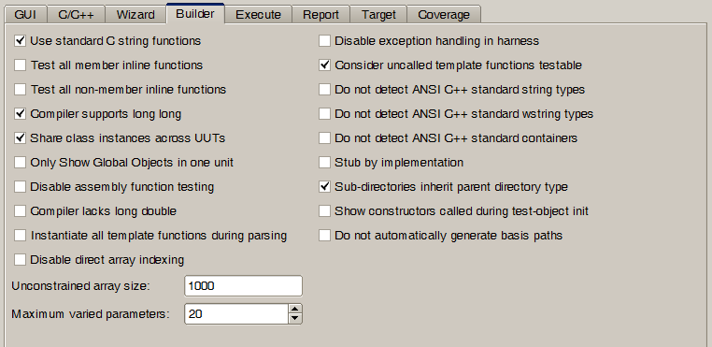
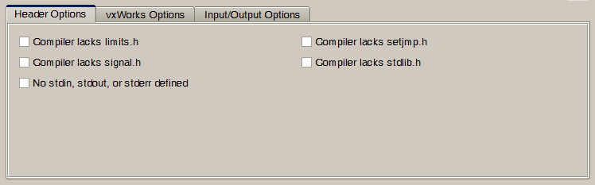
Lecture: Target Testing Concepts
Options that affect Test Harness Construction
In some cases, we cannot use the C/C++ Standard Library
Options are located in
Target Options
Builder Options
Notes:
Just talk the basic items that can be removed from the Test Harness dependencies
You don’t loose any core tool functionality in the tool by omitting this stuff
For example if you don’t have signals we won’t be able to capture raised signals
We have our own versions of the stdlib and functions like malloc, as well as string.h functions like strcpy etc.
The only function that we don’t generally provide a replacement for is sprintf
This functions is hugely complex
We generally link in the compiler’s version as “Test Code” even if the normal C lib does not have it

Slide 42
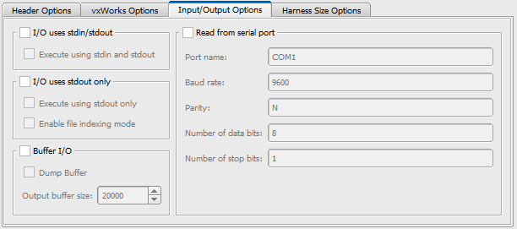
Lecture: Target Testing Concepts
Configuring Test Harness I/O
Multiple ways for VectorCAST to communicate with Harness
Text Files
Default mechanism, used in all Native testing, some targets
stdin and stdout
Harness is still data driven, input file is serialized into a data stream
stdout only
Input Data Stream is converted into a static character array
Notes:
Different I/O mechanisms are all built into the harness, and are controlled with conditional compilation
Text File I/O
Some full features RTOSs support host mapped File I/O
Integrity
VxWorks
Coverage data can be read from serial port.

Slide 43
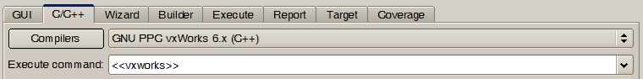
Lecture: Target Testing Concepts
Configuring Target Test Execution
Different “Styles” of Target Execution
Special Case Flag Commands << >>
Direct access to the Compiler or Debugger
Shell Script
Notes:
Special Case Flags
Used in cases where a complex series of things needs to be done
Direct Access to Compiler
Shell Scripts

Slide 44
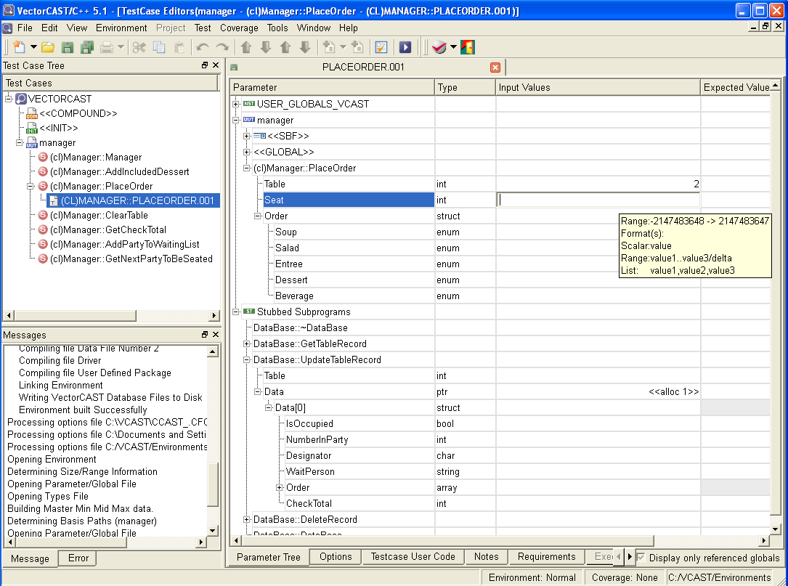
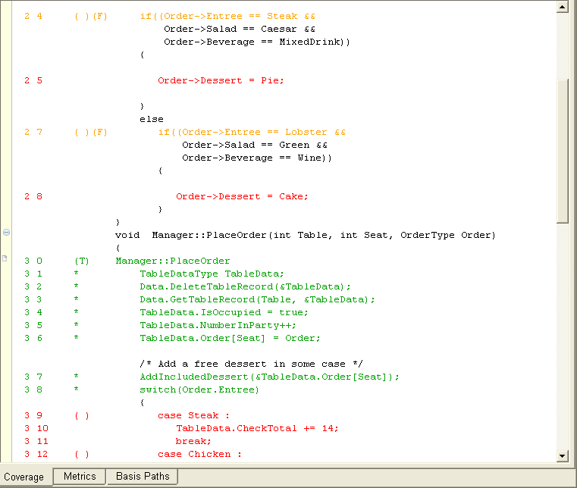
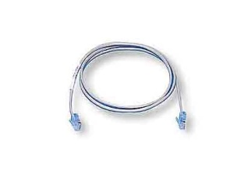
Lecture: Target Testing Concepts
RSP Connection Example
Host System
Target Connection
Target
VectorCAST
RTOS
LynxOS
MontaVista
PikeOS
QNX
Host-Based
Network Clients
ftp
nfs
ssh
rsh
scp
Ethernet
nfsd
ftpd
rshd
sshd
Application
Notes:
The next few slides have some examples of different techniques for embedded target testing
For embedded Linux, we can just use the “typical” networking protocols like ftp, nfs, rsh etc.
Even if your “real” RTOS does not have these, they can be linked in and considered “test equipment”

Slide 45
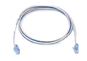
Lecture: Target Testing Concepts
RSP Connection Example: VxWorks
Host System
Target Connection
Target
VectorCAST
WDB
Ethernet
VxWorks
Allows application
download and control
Application
VxWorks
Target Server
I/O between host and target uses either the host file system or the target server file system
VxWorks
Host Shell
Simulators
VxSim
WindISS
Notes:
vxWorks allows dynamic download, so we can boot a target board with vxWorks
And then dynamically download the VectorCAST test harness to it.
Remember, the VC Test Harness is a stand-alone executable even for an Embedded target.

Slide 46
Lecture: Target Testing Concepts
RSP Connection Example: TI BIOS
Host System
Target Connection
Target
VectorCAST
GEL
Scripting
DSP/BIOS
Emulator
JTAG
CCStudio
Application
Ethernet or USB
Simulators
TI
Instruction Set
Simulators
Python
Scripting
Notes:
For Code Composer we basically “remote control” the CCS IDE via their scripting features.

Slide 47

Lecture: Target Testing Concepts
RSP Connection Example: Green Hills
Host System
Target Connection
Target
VectorCAST
MPserv
(GHS Probe)
JTAG/BDM
HW Interface
Ethernet or USB
RTserv
(INTEGRITY)
Ethernet
INTEGRITY/velOSity
RTOS
MPserv
(GHS Probe)
Ethernet or USB
U-velOSity
RTOS
Simulators
MPserv
(GHS Sim)
GHS Sim
<arch>
Ethernet
RTserv
(INTEGRITY)
Ethernet
INTEGRITY-SIM
RTOS
Notes:
We have robust and long-standing support for GHS so we support all variants of architecture for linking the harness to the RTOS as well as controlling the download and execution of the test.

Slide 48
Lecture: Environment Building Errors
Error Summary
Preprocess Errors
VectorCAST must pre-process the code under test, using your compiler
Parse Errors
VectorCAST must parse the output of the pre-processor
Harness Compile Errors
Sometimes, the auto-generated code might not compile
Harness Link Errors
Sometimes the test harness might not link
What happens when my code changes?
Notes:
Most of the modules we have gone through until now have demonstrated the “happy path”
everything works as expected
This module talks about what to do when things do NOT work
In this module we will discuss some of the common things that go wrong with Environment Building
Feel free to go through a few words about this slide
The sequence of bullets is the order VC does stuff in
Don’t go into a lot of detail of examples, just one if you want to make each flavor clear.
Pre-process
first step
this expands all macros, includes headers etc
the same compiler you use to build your app is used to pre-process
it knows all the implicit settings that it needs etc.
Parse
this is the VC tool taking the output of the pre-processor
and building a parse tree so that we can understand the code
Then we do the code gen
Compile
When we compile the auto generated code for the harness there can be errors
Could be wrong macro values etc.
Link
A variety of things can cause link errors.
Missing library for example

Slide 49
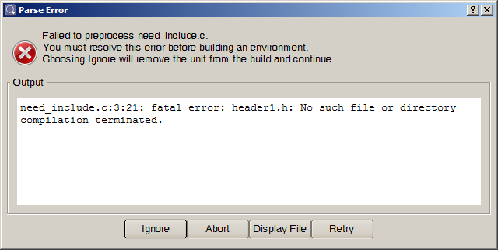
Lecture: Environment Building Errors
Preprocessor Error: Missing Include File
Notes:
When you hit the “Build” button in the new environment dialog …
Environment wizard will do a “test” pre-process, and parse on the Units Under Test
before starting the environment building.
This allows you to fix any errors that exist.
Error messages will be exactly the same as what you would get from your
compiler, if you try to pre-process a file from the command line (e.g. gcc –E)
A missing include file path is probably the most common start-up error with environment building
In the screen shot here, we would need to go back and add the path to where
“header1.h” is to the VC search directory list

Slide 50
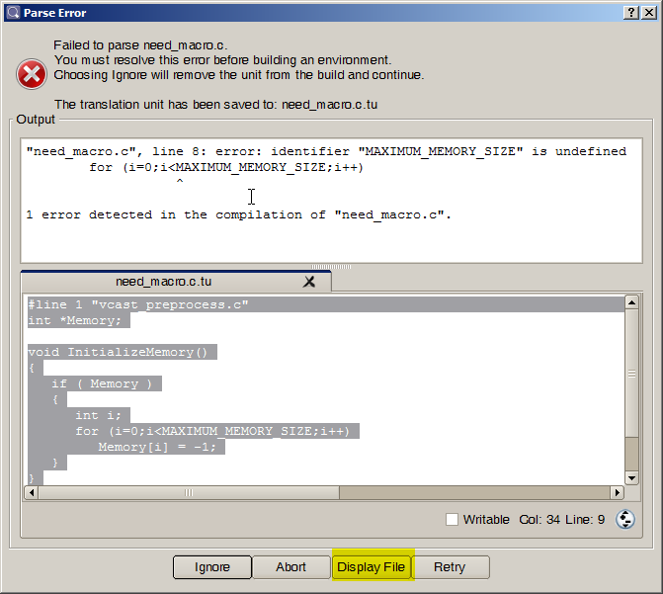
Lecture: Environment Building Errors
Preprocessor Error: Undefined Macro
Notes:
The output of the pre-processor is saved into a file called: Unit_Name.c.tu or .cpp.tu
the .tu is for translation unit
Click on the “Display File” button will open this file at the bottom of the dialog
When macro is missing, the error will be dependent on what macro is used for (function call, object, etc)
Ignore, allows you to continue on with other UUTs, any UUTs with errors will be dropped from the environment
Abort is obvious

Slide 51
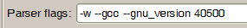
Lecture: Environment Building Errors
Parser Errors
No two compilers are alike
Even between versions of the same compiler things change
Different keyword and extensions
Compiler Bugs
As a Result, “Parses Flags” are needed
If the Template or Parse Flags are wrong …
Parse Failed: parse_error_template.tu.cpp
"c:\vcast\60a\mingw\bin\../lib/gcc/mingw32/4.5.2/include/c++/bits/allocator.h", line 146: error:
identifier "__is_empty" is undefined
template<typename _Alloc, bool = __is_empty(_Alloc)>
Notes:
The VectorCAST parser is configured for each compiler by way of Parse Flags
The parser flags are set on the “Language” tab of the Tool -> Options dialog
When you pick a compiler template, VC will automatically set the flags properly
so in general, you should not have to touch these unless VC support tells you to.
If I am using the MinGW compiler shipped with VC (based on gnu 4.0.5)
If I change the compiler template to the 3.3 compiler and do a rebuild
we will get errors like above.
I am only showing you this, because errors of this flavor are generally
caused by selecting the wrong compiler
Usually, they will be implicit keywords and modifiers are in one version of the
compiler but not in another.
For example, in this one obviously the newer GNU compiler has the implicit keyword: __is_empty
but if we tell VC that we are using the 3.3 compiler, it does not expect to see this.
See, it’s not easy building tools!!
======================================
To demo this to the class, use the source file: parse_error_template.cpp
Set up with the mingw compiler on your path
Build an environment with the compiler set to the VectorCAST MinGW C++ compiler
Then change to the GNU 3.3 and do a rebuild or update
======================================

Slide 52
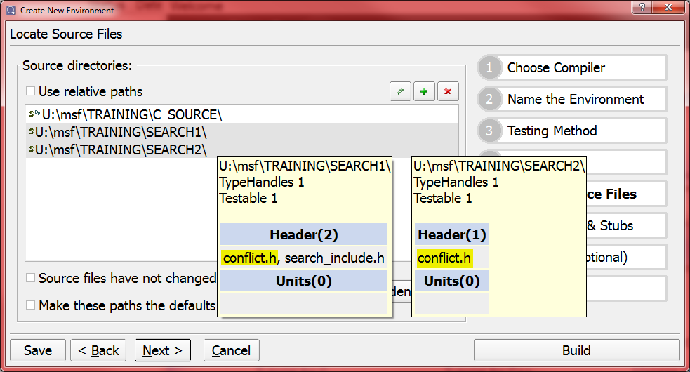
Lecture: Environment Building Errors
Conflicting Header Files
When multiple search directories contain the same header file
Compiler will generally use the “first” one it sees
If first occurrence is incorrect instance, need to reorder Source Directories
Can cause parser or linker errors, depending on how incompatible the headers are
Notes:
==============================================
To show them this one,
Build an environment for conflict.c
Add both Search1 and Search2 as search directories
If you order the search directories like this:
src, Search1, Search2 the environment builds fine
src, Search2, Search1 results in an error
==============================================

Slide 53
Lecture: Include Paths
Include File Topics
What are Include Paths?
Types of Include Paths
Passing the Include Paths to VectorCAST
Using the GUI Controls in the New Environment Wizard
Using the Environment Script
Modifying the Include Paths List
Using Relative Include Paths
Setting up “Default” Include Paths
Notes:
This module has a narrow focus, but the concepts covered are critical to understanding how VC works
The topics are listed, we have details on each item in the following slides

Slide 54
Lecture: Include Paths
What are Include Paths?
Include Paths are simply the paths (i.e. the –I options) for compiling a file outside of VectorCAST
Why does VectorCAST need to know the all of the Include Paths?
To be able to parse & preprocess the source code for the Unit
To be able to build the harness executable
To know how to handle typedefs in the Parameter Tree
To know what dependent functions to stub
For the purposes of stubbing and type handling, VectorCAST categorizes Include Paths as:
Search Directories
Library Include Directories
Type-Handled Directories
Notes:
VectorCAST calls the preprocessor to build the translation unit of the UUT and so it must pass the include paths to the header files to the compiler preprocessor. Pretty Obvious
Those directories can be from the project being tested, from third party libraries, from an RTOS and/or from the compiler’s stdlib.
We’ll show you how to add header and source file directories to the VectorCAST unit test environment

Slide 55
Lecture: Include Paths
Search Directories
An Include Path should be a “Search Directory” if:
It contains Source Files that you want to test
.c and .cpp files that exist in “Search Directories” can be chosen as UUTs
It contains Header Files that define prototypes that you want to Stub
Unresolved calls to functions from these headers will be stubbed
It contains Header Files with data types that you want to set in the Test Case Editor
Type Handling Code will be built for all structs/classes from these headers
Test Case Editor will be “aware” of these types
What type of Code is in a “Search Directory”?
Generally, all of your application code!
Notes:
The source and header directories of the project that is being tested will usually be search directories.
There MUST be at least one search directory.
Source files are those with the file extension as defined on the tools options c/c++ tab and language subtab.
If the UUT calls some function that is defined in a header that exists in a “Search Directory”
and the definition of this function is not found in a UUT, the function will be stubbed.
VectorCAST will automatically build code to manipulate the data types of variables and parameters if the “type” is a base type, or a typedef from a header files defined in a Search Directory
Also, the input and expected values for the scalar or leaf nodes of these constructed variables can be entered directly into the parameter tree. because the editor will be aware of this type (e.g. field names in a record, members in a class etc.)

Slide 56
Lecture: Include Paths
Library Include Directories
An Include Path should be a “Library Include Directory” if:
It contains Header files for Object Modules will be used during testing
VectorCAST will not generate code for
Stubs will NOT be created for these functions
Type Handling Code will NOT be created for these structs/classes
Test Case Editor will be NOT be “aware” of these types
If these types are used by a UUT parameter, the types will show up as “User” in the parameter tree
What type of Code is in a “Library Include Directory”?
API for a Library: CORBA, Boost, etc
API for an RTOS
Headers for C/C++ Run Time (generally are implicit)
Notes:
The compiler’s own standard header directory will sometimes be a library include directory or in the case that the compiler knows where its own directory is by other means ( eg gcc, msvs ) it will be left out altogether.
The compiler’s own standard header directory will NEVER be a search directory because we never want to stub functions in there in unless requested by the user
e.g. functions such as strcpy, malloc, assert, memcpy are used as part of the C language.
To stub functions in the compiler standard library, use library stubs (this is in later module)

Slide 57
Lecture: Include Paths
Type Handled Directories
A “Type Handled Directory” is a hybrid of Search and Library
An Include Path should be a “Type Handled Directory” if:
It does NOT contain functions prototypes that you want to stub
It contains Header Files with data types that you want to set in the Test Case Editor
Type Handling Code will be built for all structs/classes from these headers
Test Case Editor will be “aware” of these types
What type of Code is in a “Type Handled Directory”?
Similar types of files as Library Includes
RTOS or Libraries like Boost or CORBA
Notes:
The header directories for third party libraries (eg a mathematical library and perhaps the rtos ) will be type handled
if we do NOT want VectorCAST to write stubs and so the real library binary will be called.

Slide 58
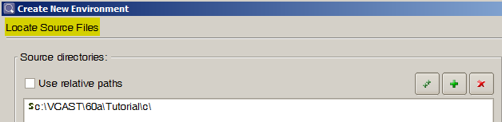
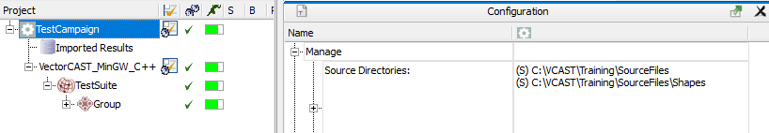
Lecture: Include Paths
The Include Path Widget
There are two places to enter “Include Paths”
Create New Environment Wizard -> Locate Source Files (Step 5)
From the VectorCAST Project: RightMouse->OpenConfiguration

Slide 59
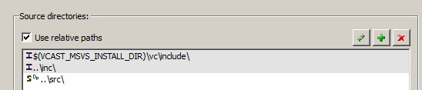
Lecture: Include Paths
Adding Include Paths
Use the green + to add one directory
Use the green ++ to recursively add directories
Use the red x to delete the selected directories
Select a List Item, and then click + or ++
Directory browser starts from the selected path
Use Relative Paths can be turned on and off
The widget will update in real-time to show the relative paths
Notes:
The green + adds a single directory
The green ++ adds directories recursively where it finds Source Files or Header Files
You can control the extensions that are considered source and header extensions in the Tool -> Options -> C/C++ Tab, Language Sub-Tab
In some cases where relative paths are used in #include statements, you may have to add “extra” directories
e.g. If a header file is included like this: #include “..\hardware\registers.h”
then you will need to include the PARENT directory of hardware, as well as, hardware itself.
If ++ adds “lots” of directories then VectorCAST can take a long time to scan the directories finding files.
VC will prompt if you want to continue while it is recursing, every 100 directories
If you have 100’s of include paths … the tools build settings repository method is a MUCH more preferable solution to the ++.
Or the tools options parse command line.
The number of directories needed is a useful measure of what DO-178B calls the data coupling of the project

Slide 60
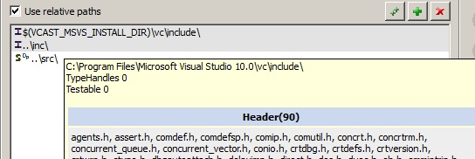
Lecture: Include Paths
Specifying and Editing Include Paths
Include Paths can be specified as either absolute or relative paths:
Include Paths can use environment variables, for example:
To point to the compiler installation directory
To point to the base of a Source Code Repository (sandbox)
Text can be pasted directly into a field
An existing path can be edited directly to make minor changes
Hover Cursor over a directory to see the content
Notes:
Relative paths are more portable
The format for an environment variable used as part of a directory path is for example
$(VCAST_MY_COMPILER_INSTALL_DIR)

Slide 61
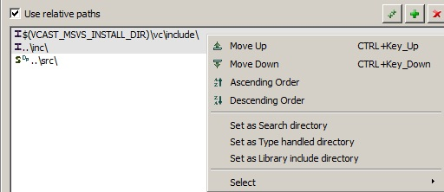
Lecture: Include Paths
Include Path Details
Context Sensitive Right-Click Actions:
The Include Path type is shown by a letter icon
S = Search, I for Library Include, T for type handled
The order of the directories is the order they will be passed to the compiler
Remember, these list items become “-I” options to the compiler
Sub-directory of explicitly listed directories inherit their parent’s type
Notes:
The order of the include paths are given to the pre-processor ( usually the –I compiler option ) usually controls the order in which
a pre- processor finds header files so the order is important when header file names are duplicated.
But it is better NOT to have duplicate header names ☺
Example of a not needing a sub-directory to be explicitly listed:
// foo.h
#include “subdir/bar.h”
Directory containing foo.h must be explicitly listed, “subdir” does not have to be listed.

Slide 62
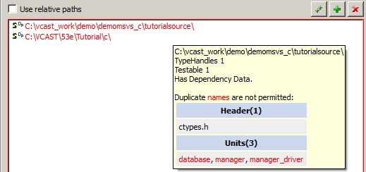
Lecture: Include Paths
Handling Duplicate Filenames
When a source file name is duplicated in search directories then
The two (or more) directory names will be highlighted in red
The hover-over tooltip will show the duplicate file names in red
The duplicated source file CANNOT be a UUT
When a header file name is duplicated in directories
VectorCAST builds a command line for the pre-processor with directories in the order in the step 5 dialogue. The pre-processor will usually select the file in the directory first in the command line.
Notes:
DON’T use duplicate file names in the project
Duplicates usually point to a configuration problem
You might have two directories called “Native” and “PPC” that have duplicated headers It is unlikely that you would WANT both paths set in your VC configuration.

Slide 63
Lecture: Code Coverage Basics
Collecting Coverage Data
VectorCAST uses source code instrumentation
We take the original source file, and change it
Basically we define a bit for each statement and/or decision point, and these get flipped in memory as program runs.
Instrumentation is highly optimized for size and speed.
Notes:
Source Instrumentation is like leaving bread crumbs behind during application testing … “Here I am 1, 2, 3 …”
We add procedure calls to your code. These procedure calls invoke our instrumentation library functions.
The instrumentation library functions basically flip bits in memory to keep track of what statements or branch outcomes have been executed/taken
It is hard to put an exact number on the overhead, as this is highly dependent on the compiler compile optimization, size of data items, and pointers etc.

Slide 64
Lecture: Code Coverage Basics
Industry Specific Coverage Types
Avionics (DO-178 B/C)
Level A (Statement, Branch, MC/DC), Level B (Statement, Branch), Level C (Statement)
Automotive (ISO-26262)
ASIL D (Statement, Branch, MC/DC), ASIL B/C (Statement, Branch), ASIL A (Statement)
Industrial (IEC-61508)
SIL4 (Statement, Branch, MC/DC), SIL3 (Statement, Branch), SIL 1/2 (Statement)
Railway (EN-50128)
SIL4 (Statement, Branch, MC/DC), SIL3 (Statement, Branch), SIL 1/2 (Statement)
Medical (IEC-62304 )
Class C (Statement, Branch, MC/DC), Class B (Statement, Branch), Class A (Statement)
Default
Statement+MC/DC, Statement+Branch, MC/DC, Branch, Statement, Basis Path
Notes:
Most industries require combinations of the basic coverage types
Each Industry has its own terminology for these coverage types:
From the VectorCAST Tools Menu, you can select the Industry Type.
This will affect the coverage choices that you see in the other menus

Slide 65
Lecture: System Testing with VectorCAST/QA
VectorCAST QA in Review
Code Coverage
C/C++ , ADA
Statement, Branch/Decision, MC/DC
Code-complexity analysis, Basis-path analysis
System / Functional Test Verification
Running your existing tests to see what code is being executed
System tests can be executed different ways:
from scripts, manually through GUI, simulator,…
Change Based Testing (CBT)
Notes:
VectorCAST/QA does more than just Coverage. It also allows you run System Tests and use CBT analysis to intelligently run those Tests.
VectorCAST/Cover is used usually during system and functional testing
Cover is capturing the code coverage you have from your existing tests
You can share coverage data between all types of testing with VectorCAST
This sharing concept is important when doing requirements based testing, where you might run your high level requirements test first and later fill in the remaining coverage with unit test.

Slide 66
Unit Testing Overview
Getting Help … Use the Help Menu
User Guides
PDF and HTML Versions
Licensing User Guide
Release Notes
Built-in Trace and Diagnostic Features
Example Environments
Pre-packaged examples to guide you through more advanced topics
Web Links for Downloading Products, Support etc.
North America Support email: support@vectorcast.com
Europe Support email: eu_support@vectorcast.com
Rest-of-World Support email: support@vectorcast.com
Notes:
Can show these items on the real GUI menu …
Getting Started User Guide has detailed step-by-step tutorials for all products
We will get into more detail about the Diagnostic Item Later in the Class
Example environments are available for C/C++ and use the built-in MinGW compiler
If you email to support, you will get an auto response with a case number, the email will also have a link for you to check the case status

Slide 67
Company Overview
Technical Information and Support
Resource | Link
Vector Main Website | https://www.vector.com
Support | support@vector.com OR support@<CountryCode>.vector.com (IE: support@us.vector.com)
Events | https://www.vector.com/int/en/events/overview/
Knowledge Base | https://kb.vector.com/
YouTube | https://www.youtube.com/user/vectorchannel
LinkedIn | https://www.linkedin.com/company/vector-north-america

Slide 68
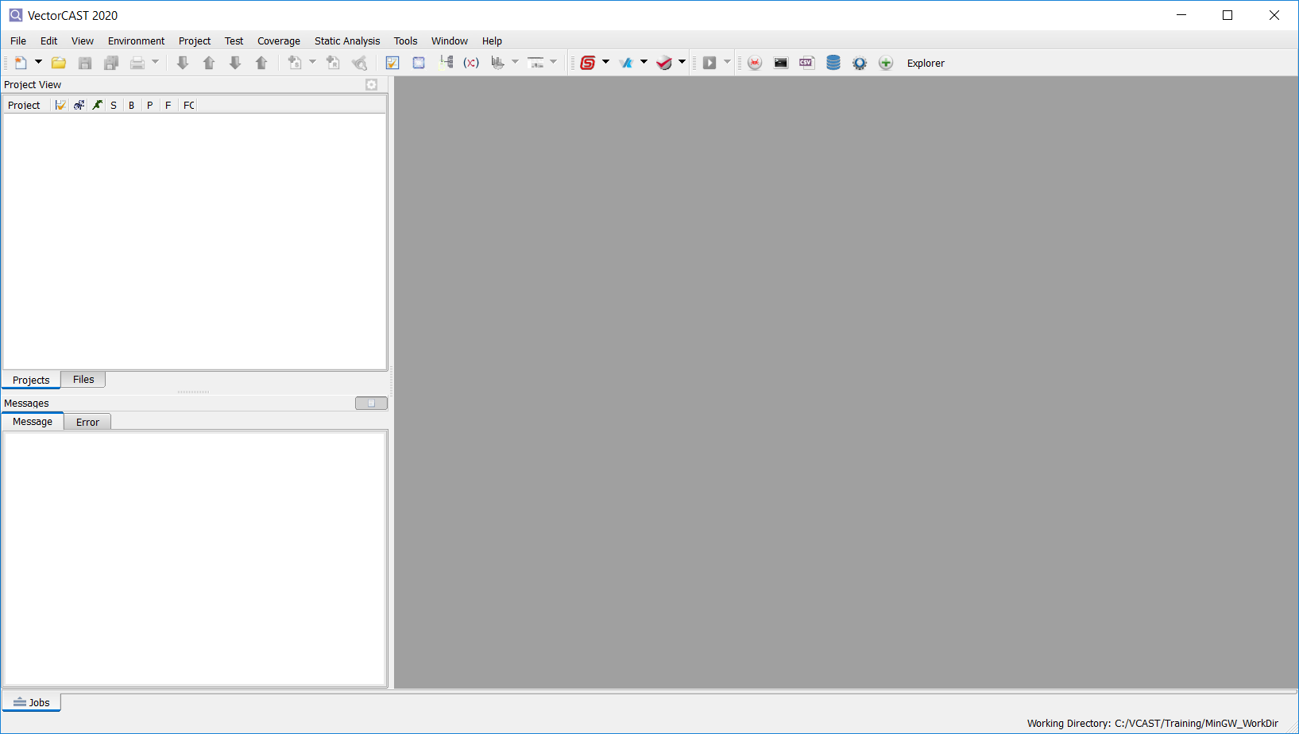
Unit Testing Overview
The VectorCAST Graphical Interface
Tool Bar
Project View
MDI (multi-document interface)
Message Window
Status Bar
Notes:
Bring up the GUI, open an environment, and show the different windows.
Encourage them to start VC and do the same thing with you, although they will not have an environment available yet.
Show them how to change the size of different panes of hide them
Show them how to undock and dock a window
Show them how to use the “View” menu to restore the default layout.
Show them the help menu
Show them how the hover over tool tips work, especially in the options dialog
Explain the status bar:
Environment Status, shows link or compile error, or normal
Coverage Status
Current Working Directory

Slide 69
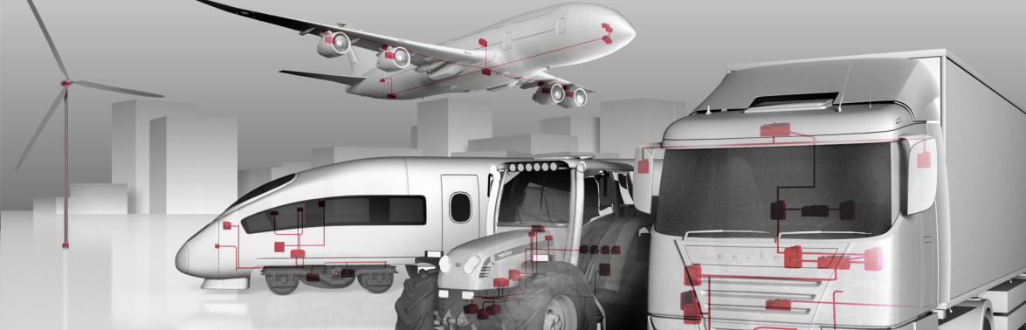
Software Test Automation for High Quality Software
Lab: Building Test Environments

Slide 70
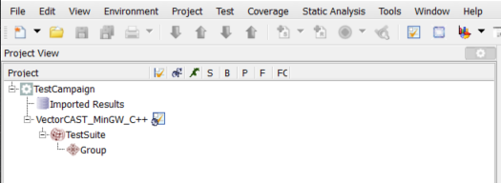
Lab: Building Test Environments
Creating a VectorCAST Project
Do File->SetProductMode->C/C++UnitTestEnvironment
If this option is greyed out proceed to next step
Set your Working Directory (File->SetWorkingDirectory)
Suggestion: C:/vcast/training/MinGW_WorkDir
Create the Project (File->New->VectorCASTProject->EmptyProject)
Enter a name (e.g. TestCampaign)
Select C/C++->VectorCASTMinGW->C++ (or C) as the compiler
Select Create
Result should look like this:

Slide 71
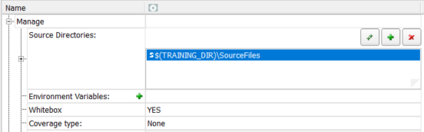
Lab: Building Test Environments
Configuring a VectorCAST Project
Once the Project is Created, set high-level configuration items
RightMouse on the top level node (TestCampaign) and select OpenConfiguration
Expand the Manage Node (on right side of screen)
Add “SourceFiles” as a Source Directory (point to wherever you unzipped the source code)
Optionally you can use environment variables to make the VectorCAST Project portable
Turn Whitebox on
Set Coverage type to None
Close the Configuration window and save
Select option to display Execution Report after test case execution
Tools->Options->GUI
At bottom of page: “After Single Test Execution show: Execution Report”

Slide 72
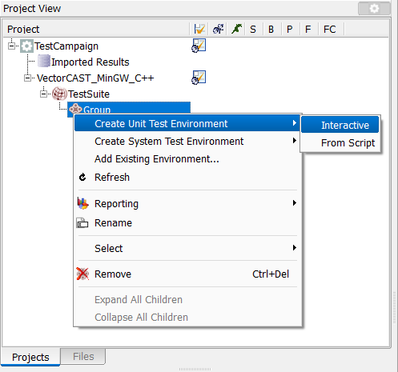
Lab: Building Test Environments
Creating an Environment
Create a Unit Test Environment inside of the VectorCAST Project
RightMouse on the Group Node and select “Create Unit Test Environment->Interactive”

Slide 73
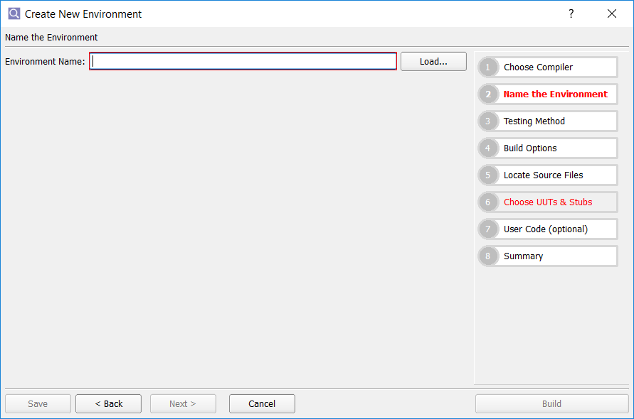
Lab: Building Test Environments
Environment Options
Browse through all 8 steps to see the various options
For this exercise, only specify the Env Name and UUT
Step 2: Name the Environment (e.g. MATH)
Step 6: Select “math.c” as the UUT
Select “Build”

Slide 74
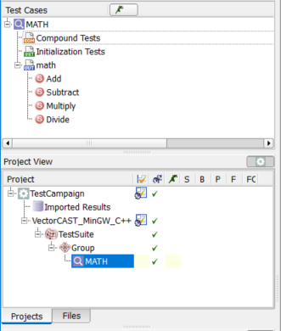
Lab: Building Test Environments
Environment within a VectorCAST Project
Upon completion, resultant screen should look like this:
Notes:
It’s probably good to go over these points before preceeding:
For this class, you will only create 1 VectorCAST Project (i.e. TestCampaign)
However, you will create several Test Environments inside of the Project
There is no need to close the Project, but Environments will be open and closed repeatedly
Only 1 Environment can be open at a time
Environments can only be opened by double clicking
Environments can only be closed by File->CloseEnv, although they sometimes will be autoclosed (when opening another env, e.g.)
Environments can also be created outside of the Project, but don’t do that!
A lot of students accidentally do this, so it may be good to show this and explain that this is legacy VC

Slide 75
Software Test Automation for High Quality Software
Lab: Creating Tests

Slide 76
Lab: Creating Test Cases
Part 1
Create an Environment for manager.c and name it MGR_UT1
Note!: RightMouse on Group Name and do: CreateUnitTestEnvironment -> Interactive
Create a Test for Add_Tax_Tip()
RightMouse on Function Name & select InsertTestCase
Change the Test Name to “Normal”
In the Test Case Editor on right side of GUI, Enter the Input Values:
check_total: 10.0
sales_tax: 0.05
tip: 0.15
Enter Expected Value on “return” of 12.0
Execute the Test and analyze the Execution Report - make sure the Expected Value matched
How many events are in the Report?
What is Event # 2? Note that this is a stubbed function.
Events 1 & 3 are the normal Entrance & Exit of the Test
Toggle back and forth between the Execution Report and the Parameter Tree (see tabs at bottom of Test Case Editor)
Enter some notes describing your test (button at very bottom of Test Case Editor)

Slide 77
Lab: Creating Test Cases
Part 2
Duplicate your test case and call it Zero_Tax
Leave “check_total” at 10.0
Change “sales_tax” & “tip” to 0.0
Enter an Expected Value of 10.0
Execute the Test. Why did it fail?
To figure out the failure, you may want to look at the source code
Select Add_Tax_Tip in Environment View & do RightMouse->OpenSource
Leave this test case as an example of a test failure
Duplicate the test and call it TenPercentTax
Expand <<GLOBAL>> node and change the input & expected value of “default_tax” to .10
Set the expected value of “log_err_cnt” to 0
Set the expected value of “return” to 11.0
Run the test and analyze the Execution Report to make sure all 3 Expected Values match

Slide 78
Lab: Creating Test Cases
Part 3
Duplicate TenPercentTax and call it CheckStubValues
Expand StubbedSubprograms
Expand log_tax_receipts and set expected value of this_tax_ttl to 1.0
Rerun the test and again analyze the report. You should now have 4 matching expected values.
On log_tax_receipts, change the input value of “return” to 1
Rerun the test. Why do one of the expected values now fail?
Leave this test case as an example of partial success
Notes:
On step 6, the test fails because log_err_cnt is incremented in this case (see source code)

Slide 79
Software Test Automation for High Quality Software
Lab: Test Case Fundamentals

Slide 80

Lab: Test Case Fundamentals
Floating Point Tolerance
Reopen the MATH environment (just double click on MATH in the Project View)
Create a test for the Divide() function.
Enter Input Values of 22 & 7 for x & y respectively
Drag Pi from the Symbolic Constants window to Expected Value Column for the “return” value
Find the (x) Icon to open the Symbolic Constants Window
Expand the <<GLOBAL>> list in the Parameter Tree
Enter a value of 3.14 for the expected value of “g_result”
Run the test
Both expected values should fail, but should be close.
3.14159, 22/7, and 3.14 are all approximate values for Pi
We will use Floating Point Tolerance to force the results to pass
Change the Expected Value of “g_result” to be “3.14+/-.01” and rerun the test
Confirm that one of the results now pass
Find the Options button at the bottom of the Test Case Editor
Experiment with the Floating Point Tolerance there to fix both results in this test case
Also note Tools->Options->Execute to set Floating Point Tolerance across the entire environment

Slide 81
Lab: Test Case Fundamentals
Character Strings
Managing Strings and Arrays
Reopen the MGR_UT1 Environment by double clicking on it
Create a Test for Add_Party_To_Waiting_List
Specify “Tom” as the input string (without the double quotes)
Expand the list of Globals (above) and then expand WaitingList
Enter a 0 on input side (to expand indices) and enter “Tom” in the Expected Value column
Run the test and make sure it passes
Changing String Display Mode
Make a 2nd test by duplicating the existing one
Go to the input Name parameter and RightClick on its type (i.e. “string”)
Change the StringDisplayMode to Pointer and allocate 4 bytes
Now, enter the individual characters into the array (i.e. T-o-m-\0) and rerun the test
The test should still pass
Change either the input or expected value to “Tim” and rerun the test, just to note the failure case.

Slide 82
Lab: Test Case Fundamentals
Arrays
Initializing Arrays
From previous test, expand the list of Globals
Select WaitingList & expand all indices (enter “0..9”)
Double Click on any one of the individual entries in the array
Select the Input Box & enter a value of “John”
Select “All” & Select Apply
Note that the entire array is initialized to “John”
Now, initialize just a subset of the array
Use the “This” or “Range” option, instead of “All”

Slide 83
Lab: Test Case Fundamentals
Additional Test Case Features
Range and List Expressions
Create a NEW test for PlaceOrder call it TEST3
Table: 1, Seat: 1, and Chicken as the Entrée
Run TEST3. How many Events are in the Execution Report?
Set a Range Value for Table: 0 through 5 (0..5), run TEST3. How many events?
Set a Range Value for Seat: 0 through 3 by 1, run TEST3. How many events?
Change to “Combination Testing” (Options tab at bottom of Test Cast Editor)
Rerun TEST3. Now how many events?
Event Limit
Set the Test Case Option for “Event Limit” to be: 10
Run TEST. How many Events?
Global Data Display
Create a NEW test for PlaceOrder call it TEST4
Table: 1, Seat: 2
For the global: WaitListSize, set an Input and Expected Value of: 1
Run TEST4. How many Expected Values are there?
Change the Test Case Option: “Display global data after” to be: “Each Event”
Run TEST4. How many Expected Values are there?
Notes:
1.2: 4 events
1.4: You can use the parameter dialog or the expression 0..5/1 in the input value cell.
24 events, 4 events per call * 6 calls to Place Order because 0..5
1.5: Still 24 events, because we are doing “parallel varying” of the values 11 22 33 43 53 63
1.6: On the Test Case Options Tab
96 because 4 events per call * 6 * 4
2.2: 11 Events. We kill harness after the 10th event, and so we always get N+1.
Draw attention to the flag text in the report that says: “Number of Events has Exceeded Selected Limit”
Mention, that the real use of this is to stop “infinite loop” type tests

Slide 84
Lab: Test Case Fundamentals
Specifying Pointer Arguments
Create a Test for Add_Included_Desert and name it PIE_ORDER
Enter a value of 1 for the input value for “Order” ptr
Note that this allocates space for the Order structure
Enter the appropriate values for the Pie path (examine the source code to figure this out)
Enter a value of 1 for the Expected value of the return parameter
Run the test and verify it passes
Now, access the value of the pointer to make sure PIE is returned
Enter a value of 1 for the expected value for “Order” ptr
This will now allow dereferencing of the pointer
Enter a value of PIE for desert on the expected value side
Rerun the test and make sure both values pass
Notes:
1.2: 4 events
1.4: You can use the parameter dialog or the expression 0..5/1 in the input value cell.
24 events, 4 events per call * 6 calls to Place Order because 0..5
1.5: Still 24 events, because we are doing “parallel varying” of the values 11 22 33 43 53 63
1.6: On the Test Case Options Tab
96 because 4 events per call * 6 * 4
2.2: 11 Events. We kill harness after the 10th event, and so we always get N+1.
Draw attention to the flag text in the report that says: “Number of Events has Exceeded Selected Limit”
Mention, that the real use of this is to stop “infinite loop” type tests
3.3: 1
3.5: 3, the VECTORCAST_INT1 value gets checked for every event except the 1st

Slide 85
Software Test Automation for High Quality Software
Lab: Compound Tests

Slide 86
Lab: Compound Tests
Dishwasher State Machine
Power On
IDLE
STATE
Stop Current Cycle
WASH
CYCLE
Start Washing
Power Off
Start
Rinsing
RINSE
CYCLE
DRY
CYCLE
Start Drying
Notes:
Before starting the lab, now is a good time to do an “abstract demo”. In other words, do a demo that is similar to what is coming up. A good example may be the “Add_Party_To_Waiting_List” and “Get_Next_Party_To_Be_Seated” functions in the manager.c module. This is a good example of why you may need to do a compound test because it makes no sense to call “Get_Next_Party_To_Be_Seated” without putting someone on the waiting list first.
…
This lab is a Simple Model of a Finite State Machine for a Dishwasher. The intent of this demo is to show these features:
Initialization Tests
Auto Init Tests
Compound Tests
Stub By Function
When IDLE, the valid events are “start washing” or “stop”.
When Washing, the valid events are “start rinsing” or “stop”.
When Rinsing, the valid events are “start drying” or “stop”.
When Drying, the only valid event is “stop”.
In the code, there are additional routines that turn power on/off by setting a global variable. The Wash/Rinse/Dry functions check that variable to make sure it’s okay to perform the cycle. This will show how to init global data with an Init Case with a Compound, or an Auto Init Case without a compound.
Also, the Rinse Cycle code makes a call to “check_heating_element()” before transitioning to the Dry Cycle. This is an opportunity to use Stub By Function because check_heating_element() returns an error by default.
Finally, a higher level Compound Test can be written to perform the entire Cycle, from IDLE thru Drying, and back to IDLE.

Slide 87
Lab: Compound Tests
Whitebox Testing
Build an environment for dishwasher_fsm.c.
Name the Environment DISH_WHITEBOX and make sure White Box is on
Create a test case for processIdleState(). Call it START_WASH
Input EVENT_START_WASH and expected value on return to STS_ALL_GOOD
Run the Test. Why did it fail?
Create an Initialization Test. Call it POWER_ON
Set the global variable powerOn to 1
Create a Compound Test
Drag POWER_ON & START_WASH to the Compound Test
Run the Compound Test and verify that it passes
Create a test for processWashCycle(). Call it START_RINSE
Input EVENT_START_RINSE and expected value on return to STS_ALL_GOOD
This will fail in a similar fashion to START_WASH
Is there a better way to solve this problem?
Flag the POWER_ON test as “Automatic Initialization”
Rerun START_WASH & START_RINSE
make sure they now pass as stand alone tests
Notes:
- Tests fail because we have not set the “powerOn” variable to True. A compound test case will be necessary
- Make sure that POWER_ON is called first. Suppose you get them in there in the wrong order, right click and move up/down
- Using a compound will solve the problem for both START_WASH & START_RINSE, but it is somewhat tedious. Is there a better way? See next slide

Slide 88
Lab: Compound Tests
Stub by Function (SBF)
Create a test for processRinseCycle and call it NO_HEAT:
Set EVENT_START_DRY as the input parameter
Set STS_NO_HEAT as the expected return value
Run the test and verify that it fails
How can you get the test to pass?
Note: You’ll need to use Stub-by-Function (SBF)
In the Test Case Editor, Expand the SBF Node
Select check-box next to CheckHeatingElement
Force it to return STS_NO_HEAT
Rerun the test and make sure it now passes

Slide 89
Lab: Compound Tests
Blackbox Testing
Build another environment for dishwasher_fsm.c.
Name the Environment DISH_BLACKBOX and make sure White Box is off (in Build Options)
How is this environment different?
Create a series of Simple Test Cases against the corresponding functions to:
Turn Power On
Transition thru the proper states of the dishwasher
Turn Power Off
Make sure each test has at least 1 expected value
Create a Compound Test that completes the entire Cycle
RightMouse on the CompoundTests node and InsertTestCase
Name the test COMPLETE_CYCLE
Drag the simple tests over to the Compound Test, in the correct order
Run all tests in the entire environment
Make sure no test cases fail (remember Compound Only!)
Notes:
Sit back and let the class solve a problem on their own.
Resulting compound case should look like this:
applyPower()
EventHandler(EVENT_START_WASH)
EventHandler(EVENT_START_RINSE)
EventHandler(EVENT_START_DRY)
EventHandler(EVENT_STOP)
Check for STS_ALL_GOOD as expected value on each slot and verify that the global “currentState” goes back to STATE_IDLE on the last step.
For Extra Credit, use “Compound Only” feature to make sure the test doesn’t get executed.

Slide 90
Lab: Compound Tests
Blackbox Testing: Extra Credit
Make duplicates of the compound test with different scenarios, such as:
Dry Event before Rinse
Restarting when Stop is inserted in the middle
Etc…
Notes:
Sit back and let the class solve a problem on their own.
Resulting compound case should look like this:
applyPower()
EventHandler(EVENT_START_WASH)
EventHandler(EVENT_START_RINSE)
EventHandler(EVENT_START_DRY)
EventHandler(EVENT_STOP)
Check for STS_ALL_GOOD as expected value on each slot and verify that the global “currentState” goes back to STATE_IDLE on the last step.
For Extra Credit, use “Compound Only” feature to make sure the test doesn’t get executed.

Slide 91
Software Test Automation for High Quality Software
Lab: Code Coverage Basics

Slide 92


Lab: Code Coverage Basics
Statement Coverage
Create a New Test Environment for manager.c
Name the Environment MGR_COVER
Set Coverage to “statement” in the BuildOptions (4)
Select “Build”
Create Test Case(s) to achieve 100% coverage for Place_Order
Set appropriate return values for each test
Take Advantage of the Symbolic Constants for the return values:
How many tests did you need?
Could you achieve 100% coverage in fewer tests?
Select the Data Summary Report icon:
CodeCoverageSummary->CodeCoverageSummary
Sort some of the columns
Enter “>2” at top of Vg Column
View the Metrics Report (Test->View)
View the Aggregate Coverage Report
Save the report to a file (File->Save).
Notes:
Step 4: With a Range Test, you can use 1 test for 100% coverage
Otherwise, you would need 5 (worst case)

Slide 93
Lab: Code Coverage Basics
Transitioning from Statement to Statement+Branch Coverage
Clear the Coverage Data: Coverage->RemoveAllCoverageData
Write a test case for Add_Included_Dessert for the Free Pie path
Name the test “FreePie”
Set expected values for the return value and for the Dessert
Create a similar test for Free Cake
Run both tests & verify 100% statement coverage for Add_Included_Dessert
Change coverage type to Statement+Branch (Coverage->Initialize)
Rerun the tests
What test needs to be added to get 100% Branch Coverage?
Create this test and call it “NoDessert”
Rerun the tests and verify 100% Statement & Branch Coverage on Add_Included_Dessert
Now, Automatically Create Basis Path Tests (RightMouse on Add_Included_Dessert->InsertBasisPathTestCases)
How do these new tests compare to your hand crafted tests?
Review Tools->BasisPath->ViewAnalysisReport
Notes:
The test that needs to be added, in response to #6, is the “neither of both”. i.e., Neither Pie, Nor Cake. This will complete 100% Branch Coverage.

Slide 94

Lab: Code Coverage Basics
Using Coverage to Debug Test Cases
How about using Code Coverage to Help Debug?
A transition from Green to Red, with no corresponding branch, is typically a clue
Insert a test for: Place_Order, call it: SEG_FAULT
Enter Table: 1, Seat: 10000
Run the test
You should see “Signal Raised” in the Execution Report
Deselect all coverage results except for SEG_FAULT
Go to top of Environment View and do RightMouse->DeselectCoverage
Select the Coverage Box next to SEG_FAULT
Open the Coverage Viewer and go to the top of the module
Press the Green Down Arrow from the tool bar
Then press the Red Down Arrow
Why did the crash occur?
Notes:
The seg fault is somewhat dependent on the RSP being used …
with MinGW, you will see the seg fault
Notes:
The 1st green line is not always the 1st executed line. i.e., the FUT may call a function above it
There is not guarantee of a transition of Green to Red because:
Some RSPs may not upload all coverage data after a segfault
If the crash happens after the 1st time thru a loop, all lines in the block will be green.

Slide 95

Lab: Code Coverage Basics
Coverage by Analysis (CBA)
Close the current environment
Set Code Coverage to Statement+Branch as the default going forward
RightMouse at top level (TestCampaign) & select OpenConfiguration
Expand the Manage node
Set Coverage Type to Statement+Branch
Create a New Test Environment using cba_example.c and name it CBA_UT
Create Tests to try and get 100% Coverage
Note that the Default Case cannot be reached
Enable CBA
Select the module name in the Environment View (cba_example)
Select the CBA Icon
In the Coverage Viewer, Select the uncovered lines
Add Notes in the right hand pane and Save
View the Metrics & CBA Reports: (All reports are under Test->View)
Notes:
Step 5: This is somewhat dependent on the compiler being used …
with MinGW, you will see the seg fault

Slide 96
Software Test Automation for High Quality Software
Lab: Test Reports

Slide 97
Lab: Test Reports
Part 1
View the Project Level Status Report from the top of the Project Tree
RightMouse->Reporting->FullStatusReport
Save the report (click into the Report Window and do File->Save)
Examine the report outside of VectorCAST (note that it’s in HTML format)
Now, re-open the MGR_UT1 environment
Add a Report Header (Tools->Options->Report->Format)
Rerun all Tests in the Environment
(assuming you have more than 1 test written. If not, add a couple tests)
Click at the top of the Environment Tree and Examine the Full Report (Test->View)
Verify that your Report Header appears at the top
Expand the list of Test Cases in the Contents
Use the Hyperlinks to quickly examine the data in different test cases
Notes:
2.5: Only the “return” value is shown in the report, the input parameter is suppressed
2.7: Only Event 2 is shown in the report
2.8: You can open the Tool -> Options, and click the “Default”
3.4: Should get a message like: “Printed boarding pass 1234”

Slide 98
Lab: Test Reports
Part 2
Find the test TenPercentTax (or create a new test for Add_Tax_Tip with Expected Values)
Run the test and examine the execution report
Experiment with these options in Tools->Options->Reports and note the changes in the report:
“Show only data with expected results”
“Show only events with expected results”
(Note that these options can help reduce the size of an Execution Report)
Create a new test for Place Order
Enter: 1 for Table, 2 for Seat
Enter “CHICKEN,STEAK” for the Entrée (no spaces!)
Enter anything you want for the other order items
Enter 10,14 as the Expected Result for the return value
Run the Test and make sure it passes
Examine the Execution Report and note the input parameters on each iteration
Now, use the Printer column to hide the Input Parameters in the report
RightMouse in the Printer column for PlaceOrder and hide all input parameters with one click
Rerun the Test and verify that the Input Parameters are absent, but not the expected value
Notes:
2.5: Only the “return” value is shown in the report, the input parameter is suppressed
2.7: Only Event 2 is shown in the report
2.8: You can open the Tool -> Options, and click the “Default”
3.4: Should get a message like: “Printed boarding pass 1234”

Slide 99
Lab: Test Reports
Part 3
Add a “File Version Command” of “dir” (or “ls -al” for Linux), as follows
Tools-Options->Report->FileVersionCommand: “dir” or “ls –al”
Run the test
Open the TestCaseManagement Report (Test->View) and note the “dir” command
Note: “dir” is just an example. Typically, you would use some type of CM command here
Add some notes to any test case
Rerun all tests in the environment
Open the Test Case Data Report and verify that the Notes appear
Open the Test Case Management Report and note that the Notes do not appear
Select “Verbose management report” (Tools->Options-Reports)
Re-open the TestCaseManagement report
The Notes should now be present
One thing to note here is that Tests do not have to be re-run if you want to modify any report. Just redisplaying the report will pick up the modifications.
Notes:
2.5: Only the “return” value is shown in the report, the input parameter is suppressed
2.7: Only Event 2 is shown in the report
2.8: You can open the Tool -> Options, and click the “Default”
3.4: Should get a message like: “Printed boarding pass 1234”

Slide 100
Lab: Test Reports
Redirecting Standard Output to Execution Report
Create a test for Clear_Table
Enter 5 for the table value
Set Tools->Options->Execute->“Redirect standard output”
Run the test
Examine the execution report and note the Standard Output at the bottom

Slide 101
Lab: Test Reports
Saving the Options
Now, lets save some of these options so that other environments can take advantage
Close any open Environment
At the top of your Project, do RightMouse->OpenConfiguration
In the Right Hand Pane, find (ctrl-F) & change these values:
Rebuild All Environments in order to pick up these options:
From top of Project Tree: RightMouse->Build

Slide 102
Software Test Automation for High Quality Software
Lab: Regression Testing

Slide 103
Lab: Regression Testing
Test Scripts
Build an Environment for manager.c or use an existing one
Build a Test for the Place_Order Function and call it: STEAK
Seat: 1, Table: 1, Order->Entrée: STEAK, Return value of 14
Run the test and make sure it passes
Export the Test Script (Test->Scripting->Export)
Make sure that only STEAK is highlighted
Name the file: myTest.tst
Edit the Test Script and make the following changes
TEST.NAME: Change Name to: CHICKEN
Order->Entrée: Change value to: CHICKEN
Return: Change value from 14.0 to 10.0
Import the myTest.tst script (Test->Scripting->Import)
Verify that you see a new test called CHICKEN next to STEAK
Run both tests and make sure they pass

Slide 104
Lab: Regression Testing
Regression Testing within the VectorCAST GUI
Turn on Statement+Branch Coverage for All Environments:
Close any open environments
RightMouse on TestCampaign & select OpenConfiguration
In the Manage Node on the right, select CoverageType as Statement+Branch
Note that this may have been done already
Run all tests from within TestCampaign:
Select the top node in the VectorCAST Project Tree
Do RightMouse->BuildExecute->Full
This should rebuild & execute all tests for all environments and may take a few minutes
Change some source code:
Outside of VectorCAST, Edit “manager.c”
In Add_Included_Desert, change “int rc;” to “static int rc;”
This won’t change the logic, but should cause some tests to be rerun
Now do RightMouse->BuildExecute->Incremental
What environments were rebuilt?
What tests were rerun?
Note: You can go into the affected environments and look at the Test Case Management report to see what tests were rerun

Slide 105
Lab: Regression Testing
Command Line Regression Testing
Note: This lab is basically the same as the previous page, except the tests are run outside of the GUI at the command line. To save time, you may want to just review this lab and run it at a later time.
Run all tests at the Command Line:
Close any environments that may be open
Close the VectorCAST Project (so GUI & Command Line don’t conflict )
Open a Command Prompt (Tools->CustomTools->CommandPrompt)
Build & Run all Environments
manage --project TestCampaign.vcm --build-execute
Examine the Full Report:
manage --project TestCampaign.vcm --full-status=full_rpt.html
Now, change some source code
Similar to what you did on the previous page
Do an Incremental Build
At the Command Prompt, enter:
manage --project TestCampaign.vcm --build-execute --incremental
Analyze the Incremental Report
Open TestCampaign_manage_incremental_rebuild_report.html

Slide 106
Lab: Regression Testing
Analytics
Select “Push to Work Area” from Analytics Icon
Analytics Browser should now appear
Click on one of the Graphs to see Source File Names
What File has the most Statements?
What File has the least Coverage?
What Function within that File has the least Coverage?

Slide 107
Software Test Automation for High Quality Software
Lab: C++ Testing

Slide 108
Lab: C++ Testing
Testing a Constructor
Create a test environment and name it SHAPES
Make sure WhiteBox is on
In Step 5 of the New Environment Wizard, add a path to SourceFiles\Shapes
Select shape.cpp and rectangle.cpp as the UUTs
Build the Environment
Create a test case for Rectangle::Rectangle(int,int,int,int)
Specify input values for all the constructor parameters.
To verify the values were inserted properly:
(See screen shot on next page for help)
Find Rectangle Instance in the <<GLOBAL>> section
Select Rectangle on expected value side
Expand the Rectangle members by clicking the + at the left side
Set the expected values to the same as the constructor input
Execute the test and verify it passes.
This proves that the constructor correctly initialized the members
Notes:
Whitebox is used so we can set expected values for the class data members
It does not matter what the input values are, say 1,2,3,4 for the 4 parameters
Note: since we are building a test case for the constructor, VC greys out the “input value” column for the sub-class and constructor

Slide 109
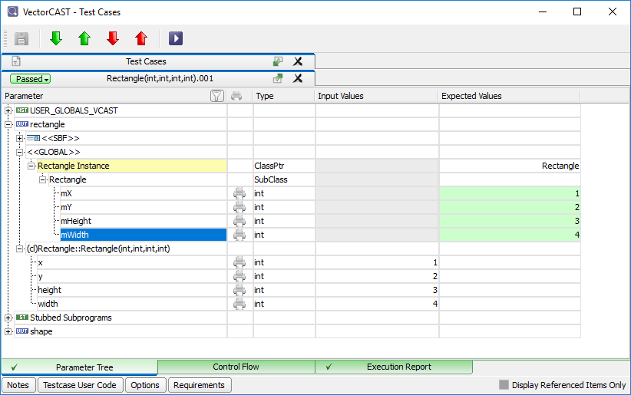
Lab: C++ Testing
Constructor Screenshot

Slide 110
Lab: C++ Testing
Testing C++ Methods
Create a test for Rectangle::getArea() called SegFault
Don’t set any input values
Run the Test - should result in a Segmentation Violation
We called a method without setting up a class instance
Create a second test case called: Normal
In the <<GLOBAL>> section, find the Rectangle Instance (in yellow)
Select “Rectangle” as the ClassPtr
Select the User Defined Constructor and enter values X=3, Y=4, Height =5, Width=10
Set Expected return value for getArea to be 50
Run the test and verify that it passes
Create a third test case called: Default
Duplicate the NORMAL test, but use the Default Constructor
Set member variables manually (mX=3, mY=4, mHeight =5, mWidth=10)
Run the test, verify that it passes
Notes:
4.1: Set the constructor parameter to be 3,3,5, 10
6.1: With the default constructor, you must set the members with the data
You have visibility to the members because you are using whitebox

Slide 111
Lab: C++ Testing
Using Init Tests to Initialize the Constructor
Use an Automatic Initialization Test Case to setup a Class Instance
Create an Initialization test called: RECTANGLE_INIT
In the Global section, select the Rectangle Instance and use either constructor
Enter the same values as from the previous test
Right-click on the test case and choose Automatic Initialization
Create a new test for Rectangle::getArea()
Set an Expected Value of 50 for the return
Run the Test and Verify that it passes
Create a Test for Rectangle:: getX
Set an Expected Value of 3 for the return
Run the Test and Verify that it passes
Note that the AutoInit Test applies to both of these tests
Notes:
Auto init test to setup the class instance eliminates some of the repetitiveness of creating member function test cases
In order to avoid having to specify the class instance for every member function test case, create an <<INIT>> test case that initializes the class instance and make that an auto-init test:
As discussed in previous modules You can also use the auto init case to setup any other global data that will be needed by all tests

Slide 112
Lab: C++ Testing
Using Compound Tests to Initialize the Constructor
Use a Compound Test Case to setup a Class Instance
Insert a test for the User Defined Constructor for Rectangle
Call it BUILD_OBJECT
Pick any Parameter Values you want
Create a Test for Rectangle::getArea(). Call it GetArea_RECT1
Create a Test for Rectangle::getY(). Call it GetY_RECT1
Set appropriate expected return values based on the parameters in Build_RECT1
Set all three Tests as “Compound Only”
Create a <<COMPOUND>> Test, called: RECT1
Drag and Drop the 3 tests into the compound in the correct order
Run the tests, and verify that the tests pass
Notes:
The compound test for getArea() is more work than simply relying on the auto init test, but we want to be sure users know how to test using compounds as well.
You can multi-select the three test case names, and choose Compound Only all at once

Slide 113
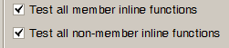
Lab: C++ Testing
Inline Testing
Create an environment for: inlines.cpp
Make sure Whitebox is on
Set Coverage Type to Statement
Turn on coverage in headers
Tools -> Options -> Coverage -> “Provide code coverage in header files”
Create Basis Path Tests for all member functions
RightClick on “inlines” & Insert Basis Path Test Cases
Run all tests
This should achieve 100% coverage (4/4 lines).
Turn on Inline Testing options in the Tools -> Options -> Builder tab
Rebuild Environment and note the new member functions that appear
Re-run the previous tests and note that coverage is now at 62% (6/8 lines).
Insert Basis Path Tests for the new functions
Run all tests and verify 100% statement coverage
Notes:
This is a separate environment exercise to cover the inlines options.
Using coverage for headers is to make more apparent the occasional difficulty in testing non-member inlines or classes that consist of inlines only.
Note that whether a function is testable does not affect whether it is coverable

Slide 114
Software Test Automation for High Quality Software
Lab: Test Case and Parameter User Code

Slide 115
Lab: Test Case and Parameter User Code
Writing Data to a File. Part 1
Build an environment for “io_wrapper.c” and call it IO_CHAINING
Create a Test Case for OpenFile and call it: OPEN_WRITE
Set the Filename to “TestOutput.txt “ & the Mode to F_WRITE
Access the return pointer by entering a 1 on the Expected Value Side
Enter a value of True for isOpen on the Expected Value Side
Run the test and make sure it passes
RightMouse on the “return” parameter from OpenFile (not “return[0]”, but “return”!)
Select “Copy User Code Tag”
Paste it into the Test Case Notes just to see what you have (“<<io_wrapper.OpenFile.return>>”)
We will chain in this value later in subsequent tests
Create a Test Case for WriteString and call it: WRITE_DATA
RightMouse on the “fp” parameter and select “properties”
Select the UserCode tab and paste on top of “expression” in top (Input) window
Resultant code should look like this:
<<io_wrapper.WriteString.fp>> = ( <<io_wrapper.OpenFile.return>> );
Set input “line “ parameter to “Hello”
Set Expected Value of “True” for return code
Notes:
In this exercise, we’re going to look at how to test a set of APIs that open, manipulate, and close a file
Obviously, you cannot setup a file pointer with a static expression
But User Code makes this relatively easy
Important points:
We can use the return value from one function as an input value for another
To test all of the file APIs with the same file pointer, all Test Cases must be run consecutively within the same execution
Compound Test Cases to the rescue!
Did you remember to set the simple test cases as compound only?

Slide 116
Lab: Test Case and Parameter User Code
Writing Data to a File, Part 2
Create a Test Case for CloseFile and call it CLOSE
Again, chain in the return value from OpenFile to the input fp parameter to CloseFile
Note1: The UserCodeTag from OpenFile should still be in your copy buffer
Note2: This is the same process that we just did for WRITE
Set the expected value for the return value as True
Create a Compound Test and call it WRITE_FILE
Drag your 3 simple tests into the compound (order matters!)
Run the Compound Test
There should be 3 expected values (one per slot) and all should pass
The resultant file should be in your working directory (i.e. “TestOutput.txt”)
Note: Look at lower right corner of GUI to find the working directory
Examine that file and make sure it contains the data you specified in the WRITE test.
Notes:
Note that it’s always a good idea to have atleast 1 expected value on each slot in the compound. It makes debugging the test case much easier.

Slide 117
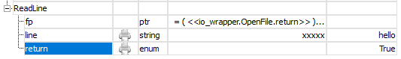
Lab: Test Case and Parameter User Code
Reading Data from a File
You should now have a Compound Test (WRITE_FILE) that creates a file with known data.
Create another Compound Called READ_FILE that verifies the data:
i.e., OPEN_READ, READ_DATA, CLOSE (see Note below!)
Should have 4 expected values in total (1 per slot, plus 2 for READ)
The 2 Compounds should be separately executable as long as WRITE_FILE executes first
Create a 3rd Nested Compound called WRITE_AND_READ that includes WRITE_FILE & READ_FILE
Run the Nested Compound to make sure it passes
Note: On the READ_DATA test, make sure that “line” is allocated on input side. This can be done by entering any string that is the same length as the string that was written ( “XXXXX” is sufficient)
Something to Consider: If you enter an empty string on the input side, the test should take a segfault. However, if you enter only 1 X, it will probably pass. Why?
Notes:
Test for ReadLine:
Still using return value of OpenFile for fp, but need new OpenFile test case to open file in “F_READ” mode
Test case for ReadLine is tricky
Need to pass in a string for input parameter that is long enough to hold incoming value.
Q: How large should we make the input allocation?
A: At least as big as our expected output, but for a general solution as large as the function uses – 100 characters.
Several ways to accomplish allocation, but easiest is to pass in a long string of garbage (“xxxxxxx….”) and then expect correct output value
Build a compound test case for OpenFile (in read mode), ReadLine, and CloseFile
Set all simple tests as “Compound Only”
Other ways to allocate the string:
Change StringDisplayMode to pointer, but this is cumbersome because you have to enter the chars individually
Write user code on the input side to do a manual malloc. This seems to be the most flexible approach
Note on the last question. The reason that only entering 1 X still seems to work is that VectorCAST allocates a buffer of 2 bytes (for the char plus the null), and when the write occurs, that buffer gets overrun. However, you are just overrunning the heap and it probably won’t be a problem unless the additional mallocs/frees were used. Definitely something you don’t want to do, but you get away with it here.

Slide 118
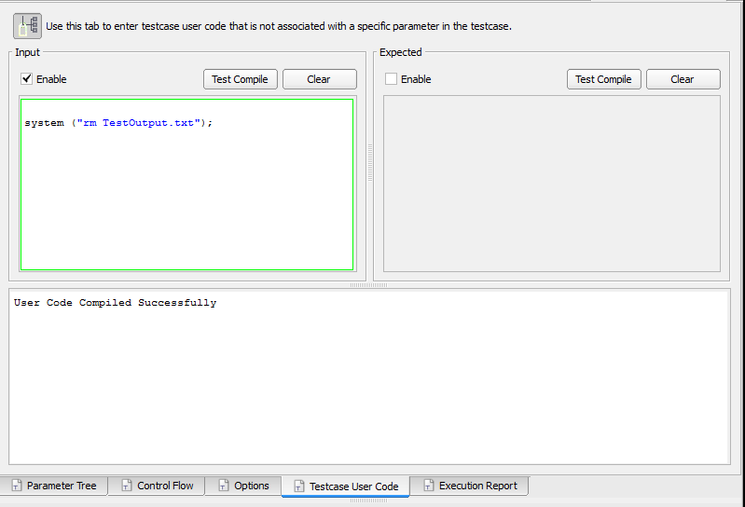
Lab: Test Case and Parameter User Code
Test Case User Code Example
When testing a file creation function, you would want to make sure the file did not exist before starting the test
Using Test Case User Code, you can delete the file before running the test
Open OPEN_WRITE Test Case
Open Test Case User Code tab
Add code to delete file*
*On Windows use
system (“del TestOutput.txt”);
Notes:
What we’re looking at:
Q: “How do I create tests that have complex inputs?”
A: “Parameter and Test Case User Code allow you to handle complex cases.”
Important points:
Test Case User Code is useful to run code prior to the Test Case function executing, or to clean up after the test completes

Slide 119
Software Test Automation for High Quality Software
Lab: Environment User Code

Slide 120
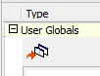
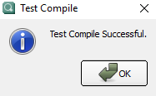
Lab: Environment User Code
Adding User Globals
Build environment for “communication.c”
Call it VOID_PTR
Turn on whitebox testing, Statement+Branch Coverage
After Build completes, Edit User Globals:
Environment->UserCode->Edit->UserGlobals
Expand the UserGlobals node on the right side of the GUI
Double Click to Open for Edit and Add the following 3 lines (note you can cut & paste these lines from comment at top of source code):
#include "communication.h"
VCAST_USER_GLOBALS_EXTERN AltCmdT AltCmd;
VCAST_USER_GLOBALS_EXTERN CourseCmdT CourseCmd;
Insert these lines just before VECTORCAST_INT1
Select the Test Compile icon
Make sure it compiles successfully ➔
Rebuild environment
Notes:
User Globals Setup:
What we’re looking at:
Q: “How do I handle functions that take “void *” parameters?”
A: “Create a User Global of the right type to hold the input parameter.”
Don’t forget:
User Globals need VCAST_USER_GLOBALS_EXTERN macro to ensure proper harness link
But they do not need to be inside the extern “C” block (for mixed c/c++ environments they do)
Declarations should look like this:
VCAST_USER_GLOBALS_EXTERN AltitudeCmdT myAltitude;
VCAST_USER_GLOBALS_EXTERN CourseCmdT myCourse;
Test Case Setup
You need 4 tests.
Here is an example Test Script:
InstructorFiles: ProcessMessage.tst

Slide 121
Lab: Environment User Code
Assigning Void Pointers to User Globals
Insert Test Case for ProcessMessage, call it: GoodCourse
Verify that AltCmd & CourseCmd show up under USER_GLOBALS_VCAST in Parameter Tree
These objects are what the “void *” parameter will point to below
Enter the following Values:
(Note: See Screenshot on next page for help)
For MessageCategory, select Change_Course from pull down
For message, select CourseCmd from pull down
Enter True for “return” on expected value side
Expand CourseCmd in User Globals and enter a value of “Pi” for newCourse.
Enter 0 for crc
Run the test to make sure it passes
Open the Code Coverage Viewer to make sure the right path is covered
Examine source code to understand what other tests need to be written
Add those Tests to Achieve 100% coverage
Make sure each test specifies the proper expected value for the return value
Notes:
User Globals Setup:
What we’re looking at:
Q: “How do I handle functions that take “void *” parameters?”
A: “Create a User Global of the right type to hold the input parameter.”
Don’t forget:
User Globals need VCAST_USER_GLOBALS_EXTERN macro to ensure proper harness link
But they do not need to be inside the extern “C” block (for mixed c/c++ environments they do)
Declarations should look like this:
VCAST_USER_GLOBALS_EXTERN AltitudeCmdT myAltitude;
VCAST_USER_GLOBALS_EXTERN CourseCmdT myCourse;
Test Case Setup
You need 4 tests.
Here is an example Test Script:
InstructorFiles: ProcessMessage.tst

Slide 122
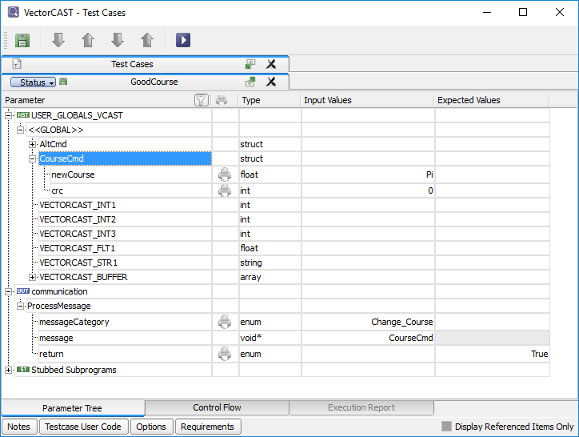
Lab: Environment User Code
Void Pointer Screenshot
Notes:
User Globals Setup:
What we’re looking at:
Q: “How do I handle functions that take “void *” parameters?”
A: “Create a User Global of the right type to hold the input parameter.”
Don’t forget:
User Globals need VCAST_USER_GLOBALS_EXTERN macro to ensure proper harness link
But they do not need to be inside the extern “C” block (for mixed c/c++ environments they do)
Declarations should look like this:
VCAST_USER_GLOBALS_EXTERN AltitudeCmdT myAltitude;
VCAST_USER_GLOBALS_EXTERN CourseCmdT myCourse;
Test Case Setup
You need 4 tests.
Here is an example Test Script:
InstructorFiles: ProcessMessage.tst

Slide 123
Software Test Automation for High Quality Software
Lab: Abstract Class and Template Testing

Slide 124
Lab: Abstract Class and Template Testing
Using the Auto-Generated Concrete Class
Abstract Class Testing
Build environment for shape.cpp (call it ABSTRACT_SHAPE)
In Step 5 of the New Env Wizard, add a path for this module (i.e. ../SourceFiles/Shapes)
Insert a test case for Shape::getX(), call it: GET
In the globals section, choose vcast_concrete_Shape as the class pointer and select either of the subclass options
Initialize mX to 1
Set the expected value of “return” to be 1
Run the test case and verify that it passes.
Notes:
<<abstract>> will appear under “Shape instance” because no concrete subclasses exist within the UUT translation unit
DummyShape must override all pure virtual functions of Shape to make it a concrete subclass
Hopefully they remember where to put this, that is the point of the lab!!
It goes into Unit Appendix User Code. Environment -> User Code -> Edit
#including header files gives VectorCAST enough information to create an instance of the child.
The tool does not need access to the definitions of the member functions – they will be stubbed in necessary.

Slide 125
Lab: Abstract Class and Template Testing
Adding other Concrete Classes to Test Against
Now create a concrete subclass of “Shape” by including the Rectangle Class
Go To Environment->UserCode->Edit->
Expand ”Unit Appendix User Code”
Double click in Value box and enter: #include “rectangle.h”
Test Compile and Save
Rebuild environment
Duplicate existing test case: GET
Select Rectangle as the subclass for Shape Instance
Select Rectangle::Rectangle() as the constructor
Initialize mX to 10
Change the expected value of “return” to be 10
Execute the test and verify that it passes
The Point of these exercises is to emphasize that an Abstract Class cannot be tested by itself. It needs to be instantiated as an auto-created concrete class, or by a user defined derived class.
Notes:
All we are trying to prove here is that you cannot test Shape::getX without a concrete subclass because you cannot initialize the class instance.
The steps to get a passing test case are just icing on the cake.

Slide 126
Lab: Abstract Class and Template Testing
Adding Template Instances to Test Against
User-defined Template Exercise
Build environment for stack.cpp (call it STACK)
Select Statement Coverage and Whitebox
Notice that no testable functions exist
Open the source code for the “stack”
Note that Stack is defined as a templated class
Make it Testable by adding user code to Unit Appendix User Code for both an Integer & a Float
Environment->UserCode->Edit->”UnitAppendixUserCode:”
template class Stack<float>;
template class Stack<int>;
Rebuild the environment
Notice that all of the Stack methods are now testable for both int and float types
Notes:
2: There are no testable functions because no template instances exist within the UUT.
The user must add an instance for testable functions to be displayed.
If an instance existed within the UUT, it would have been displayed and no user code would have been necessary
4 and 5: Insert these declarations into the Unit Appendix User Code
Environment -> User Code -> Edit
Notice that we use two different types of syntax!
7. In general, users will test templates with a representative sub-set of possible instantiating types.

Slide 127
Lab: Abstract Class and Template Testing
Writing Tests on a Template Instance
Insert a test case for Stack<float>::push, call it PUSH_FLT
Insert a value of 7 as the input value for “item”
In the <<GLOBAL>> section, Choose a sub-class for the Stack<float> instance
Verify that “mStackCount” gets set properly
This is a member of the Stack class located under Stack<float> Instance
Select “<<choose a subclass>>” on the expected value column
Now, enter a value of 1 for “mStackCount”
Execute the test to verify “mStackCount” goes to a value of 1
Create a similar test for Stack<int>, call it: PUSH_INT
Open the Coverage Viewer
Notice that we have coverage of the empty stack case in method: push
Duplicate the test and call it PUSH_INT2
Change the input and expected data to be 7,100 and 1,2 respectively
On the Options Button, select the “Display global data after” to be “After each range iteration”
Run the test, and re-open the Coverage Viewer
Hover over the source lines in the Coverage Viewer
Notice that all tests give coverage of the “empty stack” case (lines 10-12)
Notice that only PUSH_INT2 gives us coverage of lines: 2-9
Notes:
The point here is to show that coverage is not instance-specific (unless, of course, there is a template specialization)
Also to show that the coverage of the template is cumulative, even if it is called with different instances!!

Slide 128
Software Test Automation for High Quality Software
Lab: Include Paths

Slide 129
Lab: Include Paths
Search/Source Directories
Build a new environment for: vcast_time.c.
Go to “(5) Locate Source Files” and add a path to “SourceFiles\SearchPaths”
Select: vcast_time.c as the UUT & Build the Environment
You should get a Parse error
Abort and go back to Step 5 and add “SourceFiles/SearchPaths/include “as a Search Directory Path
Build should now succeed
Build a test case for function: time_add_seconds
Examine the source to understand how to test the function
Verify that the function handles overflow/carry correctly.
Run the test and verify the expected result
Notes:
1.5: The environment will have 2 directories at step 5.
2.1: INPUTS: Min 12, Sec: 55, Sec: 6. EXPECTED: MIN 13, sec 1
4. If you have this situation where you are using types in your test, then the
directory containing the header file defining those types should be
type-handled or search

Slide 130

Lab: Include Paths
Type Handled Directories
Update the environment (Environment->UpdateEnvironment) & go to “(5) Locate Source Files”
Change “include” Directory to be “Type Handled”
Make Sure only the “..\include” line is selected in blue
Right Mouse->SetAsTypeHandledDirectory & then select Update
You should now get an unresolved extern on “invalid_time()”.
(Note: Since it’s prototype is in a Type Handled Directory, it is no longer automatically stubbed.)
Update the Environment & go to “(6) Chose UUTs & Stubs”
Add “invalid_time” as an Additional Stub
Enter “Update”
Verify that your test still passes
Notes:
1.5: The environment will have 2 directories at step 5.
2.1: INPUTS: Min 12, Sec: 55, Sec: 6. EXPECTED: MIN 13, sec 1
4. If you have this situation where you are using types in your test, then the
directory containing the header file defining those types should be
type-handled or search

Slide 131
Lab: Include Paths
Library/Include Paths
Update the environment again and go to Step 5 “Locate Source Files”
Change “..\include” to be a Library Directory
Make Sure only the “..\include” line is selected in blue
Right Mouse->SetAsLibraryIncludeDirectory & then select Update
What has changed?
Notice that there are errors in the Scripting Log
Notice that the test values for “start” and “return” are missing
Notice that the “Type” column in the Test Case Editor indicates “User” for the missing values (time_T is no longer available to the GUI because it’s in a Library directory)
Extra Credit:
The typedef “time_T” is not available to the GUI, but it is still known by the compiler. Write Parameter User Code to fill in the input value and expected value with the same values as before and rerun your test.
Hint: The input user code would look something like this: <<vcast_time.time_add_seconds.start>>.mins = 1;
Notes:
1.5: The environment will have 2 directories at step 5.
2.1: INPUTS: Min 12, Sec: 55, Sec: 6. EXPECTED: MIN 13, sec 1
4. If you have this situation where you are using types in your test, then the
directory containing the header file defining those types should be
type-handled or search

Slide 132
Software Test Automation for High Quality Software
Lab: Environment Building Errors

Slide 133

Lab: Environment Building Errors
Part 1
Build an environment for: need_macro.c
Files located in ..\SourceFiles\EnvironmentBuildingErrors\src
Environment fails to build with parse error
Source code assumes MAXIMUM_MEMORY_SIZE will be defined on command line
Need to specify macro value
Do this in the “Choose Compiler” step of the Wizard
Select “Build” again
Verify: Build successful
Notes:
Macro can also be specified using Tool -> Options dialog before Environment Wizard is started MAXIMUM_MEMORY_SIZE=100

Slide 134

Lab: Environment Building Errors
Part 2
Build an environment for: need_include.c
Environment fails to build with preprocess error
Header File: header1.h and header2.h are not in the same directory as need_include.c
Need to specify an additional Search Directories
Files are in ../Search1 and ../Search2
Add these paths in the: “Locate Source Files” step of the wizard
Select “Build” again
Verify: Build successful

Slide 135
Lab: Environment Building Errors
Part 3
Code is in the directory: ./Build an environment for “changes.c”
Create a Test Case for: InitializeRecord
param1 = “Tom”, param2: 20
Save regression scripts for the environment
Now during code review, you are asked to make some changes
“Param1” should be “StudentName” (or vice versa)
“Param2” should be “StudentID” (or vice versa)
Simulate the changes
copy the file changes.c.new onto changes.c
Re-Build the environment
Test script failures because names do not match
Edit test script to fix the parameter names
Reload the test script
Verify that there are no errors and the Test Values are correct
Notes:
Note: This lab needs to be re-worked! Test Script Maintenance will now auto-fix any changes like this, so the lab needs to highlight that feature.

Slide 136
Software Test Automation for High Quality Software
Lab: Stubbing Fundamentals

Slide 137
Lab: Stubbing Fundamentals
Library Stubbing
Build environment for advanced_stubbing.c and call it ADV_STUBS
Make sure Whitebox and Statement+Branch Coverage are enabled
In step 6 of New Environment Wizard, enter “malloc” as a Library Stub
Press “Build”
Create a Test Case for: “use_malloc”, call it: “Stub”
Select malloc in the list of Stubbed Subprograms
Set a return value of NULL in the Input Values column for malloc
Run the test and look at code coverage
Verify the Null Pointer path was taken
Create another Test Case for: “use_malloc”, call it: “Real”
This time, we will not select malloc as a stub
Run the Test
Look at the code coverage
Verify that the “ok” path was taken
Notes:
Key point here is that if we had not stubbed malloc, we would NEVER be able to get into the malloc returned null branch of the IF
A nice feature of Library stubbing is that you could front-end any library routine (to capture diag info, or whatever), and then call the real routine from your stub.
For a stubbed function, where the function prototypes do not have names, parameters are given names like: VCAST_PARAM_n. where n is the position of the parameter in the formal list. For example, the MinGW prototype in stdlib.h for malloc, looks like this: malloc (size_t)/ If the prototype DID have a parameter name, you would use that name in the user code

Slide 138

Lab: Stubbing Fundamentals
Using Function Pointers
We will now test a function that reads a Water Temperature Gauge to determine if the temperature is Freezing, Boiling, or somewhere in between. Since we are testing on-host, we will create our own Temperature Gauge and stub it to return a temperature value in either Celsius or Fahrenheit.
Add a prototype for a new function in Appendix User Code
Go to Environment->User Code->Edit & expand Unit Appendix User Code
Double-click in Value column and add the function prototype
“float myGauge(void);”
Test compile and make sure it compiles successfully
Save the changes (File->Save)
Now, we need to stub myGauge
Update environment using: Environment -> Update Environment (See next page for an example)
Go to step 6: UUTs & Stubs
Add myGauge as an Additional Stub
Select Update
Make sure Test Environment Rebuilds without errors
Write Tests against temp_monitor() and try to obtain 100% Statement+Branch Coverage
Browse the source to get a basic understanding of the code
Note that “myGauge” should show up in the pull-down list for the Function Pointer
Find the Stub of myGuage and have it return appropriate temperature values for the various paths thru the code
Make sure all tests pass with an expected value
Notes:
1.0 If we want to test a function that takes a function pointer as an argument,
We can pass the address of a function that is defined in a UUT or
We can create a user defined “stubbed” function for this purpose
3.2.4 Note that the function we define matches the prototype of the function pointer parameter namely, it is a void function that returns an int.
3.3 Note that VC would not normally stub this function, because it is not “called” by the UUT however, it will be called when we pass it as a function pointer in our test if we don’t stub it, we will get a run-time error

Slide 139

Lab: Stubbing Fundamentals
Additional Stubs Screenshot

Slide 140
Lab: Stubbing Fundamentals
Return Data List Options
In this section, we will test a function that reads a series of digits from a keypad, and converts those digits to an integer. Since we don’t have a real keypad, we will stub the low-level input routine to return the digits.
By looking at the source code, note that:
The input argument specifies how many digits to read
“read_key_pad()” will need to be stubbed with a corresponding list of input characters
If the input length is 4 and digits 1,2,3,4 are returned from the stub, an integer value of 1234 should be returned.
Write a few simple tests against get_numeric_string() to understand the function
Now write one Range Test that reads in 3 different values representing a User ID
The user ID is of the form “XXX YY ZZZZ” (i.e. 3 digits, 2 digits, 4 digits)
Enter “1,2,3,4,5,6,7,8,9” as the input characters on the stub of “read_key_pad”
Specify a “3,2,4” as the input string lengths
Enter “123,45,6789” for the expected return values
Did the test fail? What is the actual value of the 2nd & 3rd strings?
Try Test Case Option “Multi-return spans range iterations” and it should now pass
See example screen shot on next page
Notes:
When doing the range test, the results for the 2nd string will have some of the contents of the 1st string. That’s because we are not spanning the entire range. Setting the option should fix the problem.

Slide 141

Lab: Stubbing Fundamentals
Screenshot: Return Data List Options

Slide 142
Lab: Stubbing Fundamentals
Object Initialization User Code
Create a Test Case for: “log_error_msg”
Pass in any string as the log msg
Run the Test
Look at code coverage
How do you test for a non-zero value of debug_flag?
Use Object Initialization User Code to set value of debug_flag
Go to Environment -> Object Initialization User Code
For Object: “debug_flag”, specify a non-zero value in the “Initialization Code” section
For Example, type in “= 1”
Test Compile and then Save and Link (from pull down)
Run the test
Look at code coverage.
Is it possible to get 100% Branch coverage on this function?
Note: (If you’re curious, edit advanced_stubbing_expanded_driver.c and search for “debug_flag” to see how object initialization works)
Notes:
It is not possible to get 100% code coverage (unless you consider CBA). You can only cover one of the branches, depending on the value of the constant.
This may be a good time to discuss CBA (Coverage By Analysis).

Slide 143
Software Test Automation for High Quality Software
Lab: CSV Importing

Slide 144
Lab: CSV Importing
Mapping CSV Data to Parameters
Build an environment for line.c and call it CSV_IMPORT
Create a CSV Map for findY()
Right Mouse on findY and select “Generate CSV Map”
In the Map Window on the right, browse to ../SourceFiles/SupportFiles/line.csv
Select the Load button
You should now see the loaded data
Note that the 1st row is just header info
All other rows represent individual test cases
Slide over the CSV Options next to the data (see screen shot on next page)
Enter 1 for “Number of rows before start of data”
Enter 1 for “Row containing column headings”
Drag the Column Headers down to the corresponding parameter values
i.e. Drag Slope from Column 2 down to the “m” parameter
Do the same for the other 3 parameters (note: Y goes to expected value of return)
Right Mouse on the Map name in the Environment View and select CreateTests
Run the Tests, making sure all tests pass
Now do a similar map for findX()
Why do 2 of the tests fail?
Notes:
This lab is probably better to do together as a group, with help from the instructor.
If you do not set the Number of rows before start of data to be 1, there
will be a script import error, when it reads the first row as “data”
There should be 42 tests generated if you do it right, and they all pass
Just drag the columns down to X, Y, B and return parameters
On “findX”, there will be 2 failures because of divide zero
Test cases can be fixed by changing the code to check for a Zero Denominator, or by selecting NaN as the expected value.

Slide 145

Lab: CSV Importing
Screenshot: CSV Mapping
Select this icon to see CSV Options
Notes:
This icon is very hard to find, but is handy to hide/display the Map Info next to the data.

Slide 146
Software Test Automation for High Quality Software
Lab: Additional Test Case Options

Slide 147
Lab: Additional Test Case Options
Drag and Drop Tests Across Functions
Build an environment for control_flow.c
Dragging & Dropping Tests across functions
Insert a Test for “computeBaseArea” and call it AreaTest
Enter values 2,3,4 for the global width,length,height
Enter an input value of BOX on the “shape” parameter
Enter an expected value of 6 for the Base Area
Run the test. Why did it fail?
Enter return value of 1 on the validShape stub and make sure it now passes
Drag & Drop the Test Case over to computeVolume (remember: Alt->Click).
Rename the test to VolumeTest1
Notice that the Global values were copied, along with the stub parameters, but the input & expected values of the function under test were not copied.
Enter BOX as the input parameter and an expected value of 24 for the volume
Make sure the test passes
Notes:
The intent of this exercise is to show that Dragging & Dropping does not copy over the calling parameters, but it does copy over the global data & stubs. Both computeBaseArea & computeVolume use the same global data and stubs, so little work was needed when the test case was copied over.
Not copying over the calling params is okay. Calling params are usually different between functions anyways. Copying the global data & stubs can be a bigger time saver. If you find yourself doing this a lot, you may ultimately want to drag this up to an Init test case and make it AutoInit.

Slide 148
Lab: Additional Test Case Options
Duplicating Tests
Duplicating Test Cases within the same function
Duplicate VolumeTest1 and call it VolumeTest2
Note that all input & expected values are copied over (Globals, Stubs, & function-under-test parameters)
Run the test case to make sure it passes
Notes:
Remember you can copy paste values right click, or ctrl-c ctrl-v
6 Range Iterations, 12 total events
Number of Range Integrations is always the number of partitions plus 1. The exception to that rule is if the number of partitions is set to zero. In that case, there will affectively be 1 partition & 2 range iterations.

Slide 149
Lab: Additional Test Case Options
Partitioned Test Cases
Insert a “Partition” Test Case for partitionExample and name it 5_PARTITIONS
In the Test Case Options tab, Set the Number of Partitions to: 5
Run the Test, how many Range Iterations are created?
Duplicate the Test and name the new test 10_PARTITIONS
Change the Number of Partitions to: 10
Run the Test, how many Range Iterations are created?
Notes:
Remember you can copy paste values right click, or ctrl-c ctrl-v
6 Range Iterations, 12 total events
Number of Range Integrations is always the number of partitions plus 1. The exception to that rule is if the number of partitions is set to zero. In that case, there will affectively be 1 partition & 2 range iterations.

Slide 150
Lab: Additional Test Case Options
Control Flow Testing
Control Flow Test Case
Insert a Test Case for controlFlowExample, name it TEST_ONE
Using the Test Case Editor, add the correct values for the control flow
Run test, ensure that it passes
Duplicate the test
Add incorrect items to the control flow
Run Test Verify that it fails
Notes:
2.2: Remember you can control the columns being search via the pull down list next to the “FIND” Button in the search bar
4.4: The globals: dimensionX,Y,Z are not used in function: controlFlowExample

Slide 151
Lab: Additional Test Case Options
Find, Filter, & Cross Reference
Filtering the Test Case Tree
Search For (ctrl-F): “compute”, and click the “Filter” checkbox on and off
Filtering the Parameter Tree
Open the Test Editor for any test
Search for: “shape” and click the “Filter” checkbox on and off
“Display only referenced globals” checkbox
Open the Test Editor for a test case for computeVolume
Expand the SBF list and the GLOBAL list.
Click on the various global variables and notice what changes in the GUI
Click on the “Display only referenced globals” checkbox at bottom right of editor
Notice how the Test Editor Display changes, why?
Notes:
2.2: Remember you can control the columns being search via the pull down list next to the “FIND” Button in the search bar
4.4: The globals: dimensionX,Y,Z are not used in function: controlFlowExample

Slide 152
Software Test Automation for High Quality Software
Lab: Code Coverage Options

Slide 153
Lab: Code Coverage Options
Coverage Animation
Build an environment for units “date” and “utilities”
In Step 5, add a path for these modules (i.e. “../CodeCoverageOptions”)
Select Coverage Type Statement+Branch
Enable Coverage Animation and Initialize Code Coverage
Turn on “Animation Mode” in Tools->Options->Coverage tab
Rebuild the Environment
Use “Coverage Animation” on “DateString” test, as follows:
Build a test case for “DateString” in “date” (converts numbers to text)
After running the test, use the coverage animation as follows:
Right Mouse on the Test & select “Activate Coverage Animation”
Play with step forward/back, goto start/end and breakpoint buttons that should now appear

Slide 154


Lab: Code Coverage Options
Coverage Reporting
Create Basis Path Tests for functions both “utilities” and “data”
View the Code Coverage Summary to see coverage status
Select column headers to change display order
User filtering to weed limit the amount of data (e.g., enter “>2” at the to of the Vg column)
Now view the Metrics Report
Go to Tools->Options->Report->FilterMetricsReport and try the settings below to see how the report changes (note that you need to close & reopen the report to see the changes)
“Include Subprograms and units”
“Include only units”
“Include only Grand Totals”

Slide 155
Lab: Code Coverage Options
Other Options
Get code coverage for function: TRACE (defined in utilities.h)
Select “Test all non-member inline functions” in Tools->Options->Builder
Select “Provide code coverage in header files” in Tools->Options->Coverage
Rebuild the Environment
Create and Execute a test for ConcatenateStrings
Look at code coverage for file: utilities
Look at the code coverage for file: date
Turn on Option: “Show in-lines as covered in all units” in Tools->Options->Coverage
Reinitialize Coverage (Coverage->Initialize->Statement+Branch)
Run test for ConcatenateStrings again
See if the coverage for the “date” module has changed
Achieve 100% Branch Coverage in function: MaxDays
Create 2 tests, one for Feb 2000 & one for Feb 2001
Also create tests for Jan, Mar-Dec (range!)
You should now have less than 100% branch coverage.
What test needs to be added to gain 100% branch coverage (Hint: Feb, 2004)?
Now, turn on “Instrument implicit default case for switch-case blocks” in Tools->Options->Coverage
Re-init the coverage, rerun the tests, and note the default case is not covered
Create a test for the “default” case to get back to 100% Statement & Branch Coverage
Notes:
1.5/6 - TRACE should be shown as covered in “utilities”, but not in “data”
1.10 – TRACE should now be shown as covered in both modules
2.7 Add test for Feb 2004 to gain full coverage

Slide 156
Software Test Automation for High Quality Software
Lab: MC/DC Testing

Slide 157
Lab: MC/DC Testing
Testing From Requirements and MC/DC Analysis
Overview:
Part 1:
We will be testing a simple function that determines if a company is open for business based upon the specified day & time. The requirement is that the business is open 8am (800) to 5pm (1700) everyday of the week, but closed on Sunday.
Function API: int open_for_business(int time, enum day);
The function returns a simple True/False (0/1) value to indicate if it’s open. The time is in military time (e.g. 1700 is 5pm). The day of the week is an enumerator from Monday thru Sunday.
The objective in this 1st part is to write tests from requirements, and then see if they satisfy MC/DC
Part 2:
In this section, we will be writing tests for the sole purpose of satisfying MD/DC, without concern for the functional requirements. The objective is to understand the mechanics of MC/DC testing.
Notes:
The main point of the 1st part of this lab is that tests should be written from requirements, and then MC/DC analysis should be done to verify that the tests provide sufficient structural coverage.
The 2nd part of this lab has the students more focused on writing tests just for the purpose of satisfying MC/DC. This should not be the usual approach, but it’s a good exercise to understand the fundamentals of MC/DC.

Slide 158
Lab: MC/DC Testing
Part 1: Writing Functional Tests that satisfy MC/DC
Build an Environment for mcdc_example.c
Select Statement+Branch Coverage
For the function “open_for_business()”:
Write 2 tests for the “open” and “closed” conditions
Make sure to check the return value on each test.
Verify 100% Statement + Branch Coverage
(You may want to save the Coverage Viewer screen shot as a text file (.txt), or as a screen snip for comparison after the next step).
Now enable Statement + MC/DC (Coverage->Initialize) and rerun the tests
Note the differences in the Coverage Viewer when MC/DC is enabled
See if you can add functional tests to meet 100% Statement + MC/DC Coverage
Notes:
Highlight the differences between the Coverage Viewer on Branch vs. MC/DC
The general rule for how many tests are required to satisfy MC/DC is N+1, or 4 in this case. How many tests did the students write?
Here are 4 tests that satisfy MC/DC:
Time = 1200, Day = Mon, Res = 1
Time = 1200, Day = Sun, Res = 0
Time = 0000, Day = Mon, Res = 0
Time = 2000, Day = Mon, Res = 0

Slide 159

Lab: MC/DC Testing
Part 2: Creating MC/DC Tests from the Truth Table
For Conditional_Example () function:
View the Equivalence Pair Table for Conditional_Example (Tools->MC/DC->ViewEquivalenceMatrices)
Create 2 Test Cases that satisfy “Pair Coverage” for condition “a”
(For your sanity, use a naming convention for the test names, e.g.: PairA_Row3_TFT_T)
Create additional Test Cases that give you “Pair Coverage” for “b” and “c”
Run all tests and verify 100% MC/DC pair coverage
Now View the Equivalence Pair Table in the Coverage Viewer
In the Code Coverage Viewer, click the red arrow to the left of the Conditional
The Equivalence Pair Matrix should appear at the bottom of the viewer
Notice that the pair coverage gets updated as you click/unclick the checkboxes on the test cases
Notes:
“ViewEquivalenceMatrices” is good from a static anlaysis point of view, but once you have run 1 test case, you can see the same info from the Coverage Viewer when you select the arrow.
You may want to talk about the suggested naming convention before they start the lab. They can use this convention, or develop their own.
PairA_Row3_TFT_T
Row3 is one of the Rows for the Pair for Subcondition A. The values of A-B-C are T-F-T, and the result is T
They student may end up with 6 test cases (2 rows for each pair), but then should realize they can eliminate duplicates and hopefully get back to N+1 (or 4 in total).
4.1: TTT / FTT give you pair coverage for “a”
4.2: Add TFF to complete the “pair” for “b”, add TFT to complete the “pair” for “c”
Start a discussion about the fact that there is short circuiting
For example, turn on the coverage check for TTT only, notice that rows 1 and 2 are “covered”
This is because Once you have TT c does not matter!

Slide 160
Lab: MC/DC Testing
Extra Credit
Think about the API and the requirements for “open_for_business”. See if you can come up with additional tests that fully test the interface.
There is a bug in the function “open_for_business()”. Did any of your tests uncover the bug?
Classroom Discussion:
Why did the initial Tests from Part 1 (that satisfied MC/DC) not necessarily uncover the bug?
What additional functional tests did you create?
What is a better approach to testing? Part 1 or Part 2?
Notes:
The bug occurs when a bad day is entered. E.g., enter a value of 8 for the day & 1200 for the time. You would expect that the business would be closed, but the function returns “open”
Also, there may be a bug because a time of Monday at 800 is “closed”. The requirements should probably be more clear on that.
MC/DC does not necessarily find bugs, it just confirms that the code (as written) has been fully executed. i.e., “MC/DC is necessary, but not sufficient”.
Testing should always be done from a functional requirement point of view (i.e. Part 1). MC/DC is a confirmation that those tests meet structural testing guidelines.
Here are some other functional tests that may be good to add:
A combination test across all days of the week & a list of times. E.g., using a range on all the days (i.e. Mon..Sun/1), and a list on the times (0,900,1800). Show how “set expected values from actual results” may be useful here on the return value (i.e., it basically shows the order of the combinations).
End point testing on the time parameter, e.g.:
Times of 759,800,801,1659,1700,1701
Negative values for day and time
Way out of range values for day & time (e.g. 1,000,000 for time, and maybe 60,000 for day – note that day is probably an unsigned short.). Point out that sometimes, enums are used as indexes into arrays, so testing with large values is a good test.
Take away points:
MC/DC does not guarantee proper functional testing
Small/trivial functions sometimes require many tests. It all depends on the interface, and not the # of lines of code.

Slide 161
Software Test Automation for High Quality Software
Lab: System Testing with VectorCAST QA

Slide 162
Lab: System Testing with VectorCAST/QA
QA Process Overview
Create a New QA Environment
Instrument the Files
Build the Executable
Run the Executable
View Coverage Data in VectorCAST/QA
Integrate System & Unit Coverage Results
Notes:
There are several goals of this lab:
Understand the fundamentals of the legacy Cover product. i.e.:
Instrument from a Cover env
Build the Executable outside of Cover
Perform System Testing with a Human Interface (this is how most customer do their System Testing)
Import results back into the Cover env
Figure out how to do System Testing from a Script, outside of VC. If the tests can’t be scripted, then QA is not as effective
Build the executable from within VC, but still run the tests outside of VC, either with a script of with the Human Interface
Then, build & execute tests from VC
And Finally, integrate System Test Results with UT

Slide 163
Lab: System Testing with VectorCAST/QA
Creating a QA Environment
Create a new Test Suite
In VectorCAST Project Tree, RightMouse on Compiler Node for MinGW and “Add TestSuite”
Name the Test Suite “SystemTestSuite”
If you’d like, rename the other Test Suite to “UnitTestSuite” to differentiate
Create a new Group
RightMouse on SystemTestSuite Node and select “Add Group”
Name the Group “SystemTestGroup”
Create a System Test Environment
RightMouse on the Group Node and select “Create System Test Environment->Interactive”
Go through 4 Step Process
Step 1: Choose Compiler (use Defaults)
Make sure the check box is selected on the C/C++ tab.
Step 2: Name the Environment: DINER_SYSTEM_TEST
Step 3: Locate Source Files
On Base Directory select $(TRAINING_DIR) from the drop down
Click on Source Files folder
On Right, Select only database.c, manager.c, & manager_driver.c
Step 4: Coverage Options (use Defaults)
Select Build Button to Create the Environment
Notes:
Note: This lab assumes that the Cover Env will be created in the VectorCAST project created from the prior UT labs

Slide 164
Lab: System Testing with VectorCAST/QA
Instrumenting the Code
Instrument the Code
In the Environment View select all three files: database.c, manager.c and manager_driver.c
Right click and select Instrument->Statement+Branch
Close the Environment
Append c_cover_io.c file to main
Right click on manager_driver.c and select Append Cover IO

Slide 165
Lab: System Testing with VectorCAST/QA
Using Python to do the Build
Now we will edit the QA Python Script so we can build from VectorCAST
RightMouse on the DINER_SYSTEM_TEST environment in the Project View
Select SystemTesting->EditScript
This should bring up the “system_tests.py” Python Script in the Editor
Search for “locationWhereWeRunMake” (should be around line 40)
Enter ‘c:/VCAST/Training/SourceFiles’ within the single quotes
If your path is different for SourceFiles, use your path
Now find “topLevelMakeCommand: (down a few lines)
Enter ‘bld_cover.bat’
Save your changes and close the editor window
RightMouse on the DINER_SYSTEM_TEST environment and select “build”
Notes:
Edit the Python Script to do the Build from QA

Slide 166
Lab: System Testing with VectorCAST/QA
Viewing the results
From the VectorCAST Shell, Run the Executable
(Select Shell Icon on the toolbar or Tools->Custom Tools->CommandPrompt
cd ..\SourceFiles
diner.exe
Pick any options you want & then quit out of the executable
Open the QA Environment by double clicking on DINER_SYSTEM_TEST
View Coverage Data
Environment->AddTestResults
Browse to TESTINSS.DAT (in SourceFiles) and Open
Give an appropriate name that corresponds to the test and select “OK”
View the coverage for “manager.c” and make sure it correlates to your test
You may need to select the check box next to your imported “Test Results” in the lower pane.
Run Additional Tests to Get Familiar with the Process
Notes:
This slide is basically using the Legacy version of VC, where building & executing is done outside of VC

Slide 167
Lab: System Testing with VectorCAST/QA
Scripting System Tests
The prior tests required human interaction, which is not regressionable. If possible, it’s good to make the tests scriptable. With the “diner.exe” executable, you can do so by capturing the user input to a file.
Look at the *.SysTst files in ..\SourceFiles
From the VectorCAST Shell, run Diner.exe with one of the System Test Files, e.g.:
diner Pie.SysTst
This should create a new TESTINSS.DAT file, just like the interactive tests
Import this new TESTINSS.DAT (similar to the previous page)
Verify the Coverage results for this test
Notes:
This slide is basically using the Legacy version of VC, where building & executing is done outside of VC

Slide 168
Lab: System Testing with VectorCAST/QA
Executing the Tests from VectorCAST
Since the tests can now be scripted, we will add them to the QA Python Script so that everything can be done from VectorCAST/QA.
Close the environment (File->CloseEnvironment)
RightMouse on DINER_SYSTEM_TEST in the Project View
Select SystemTesting->EditScript
This will bring up “system_tests.py” Script in the Editor
Search for “locationWhereWeRunTests” (around line 48) and set it to ‘c:/VCAST/Training/SourceFiles’
Now find “nameOfTestExecutable” (down a couple lines)
Enter ‘./diner.exe’
Down a few lines you’ll see “masterListOfTestCases” Add in some test cases to the list, e.g: self.masterListOfTestCases = [TestCase("Pie.SysTst"), TestCase("Cake.SysTst"), TestCase("LargeOrder.SysTst")]
Save the changes to the Python Script
Notes:
The build is being done now from VC, but the exaction is done outside of VC

Slide 169
Lab: System Testing with VectorCAST/QA
Controlling what System Tests to Run
Select DINER_SYSTEM_TEST in the VectorCAST Project Tree
RightMouse->Build/Execute
Open the Jobs window to see how the system tests were built & run
Open up DINER_SYSTEM_TEST
Verify the results match your system tests

Slide 170
Lab: System Testing with VectorCAST/QA
Integrating System & Unit Testing Results
Close the DINER_SYSTEM_TEST Environment
Open up a Unit Test Environment for “manager.c” (e.g. MGR_UT1)
Make sure Coverage is set to Statement+Branch
Import the System Test Results
Coverage->ImportResultsFromEnvironment
Traverse to c:\VCAST\Training\MinGW_WorkDir\vcast_qa\DINER_SYSTEM_TEST .vcp
Select all the results
Expand the Imported Results Node and select all check boxes
Write additional Unit Tests to try and get 100% coverage on this file
Notes:
Integrate System Test with Unit Test by importing the System Test Results back in to a UT environment

Slide 171
Software Test Automation for High Quality Software
Lab: Advanced User Code

Slide 172
Lab: Advanced User Code
Device Driver Testing
In this lab, we will test out the layers above the hardware interface and stub the hardware functions.
Layer 2
Packet Level
Testable
Layer 1
Byte Level
Testable
Hardware
Interface
Stubbed
Notes:
The intent of this lab is twofold:
Shows how you can test the upper layers of a device driver without needing the hardware
Combines the different types of User Code into one example

Slide 173
Lab: Advanced User Code
Adding Environment User Code
Create a Test Environment for “datalink_transmit.c” and call ADV_USER_CODE
Write stub code for “calc_crc()” to return a constant value
Environment->ConfigureStubs->Edit
Find calc_crc & add this code to “Beginning of stub”:
return(0xAB);
Test compile & Save!
Also write stub code for “log_msg()” so we can capture any output in the execution report
printf(“\n%s\n”, msg );
Test Compile & Save!
Set option “Redirect Standard Output” in Tools->Options->Execute
Add Stub Counter to User Globals
Environment->UserCode->Edit->UserGlobals
Add: “VCAST_USER_GLOBALS_EXTERN int my_stub_ctr;”
Test Compile & Save!
Select Tools->Options->Builder->”Test All non-member inline functions”
Rebuild The Environment

Slide 174
Lab: Advanced User Code
Stubbing Out the Hardware Interface
Create a Test For pkt_transmit() & call it SMALL
Msg = “abc”, msg_len = 3, msg_num = 0x99
Set return code to TX_GOOD
Use SBF to stub hw_send_rts() & hw_tx_byte()
Just checkmark the boxes – no action required
Use SBF to stub hw_check_cts() and return a 1
Run Test and make sure it passes
The above test is a little weak because we don’t know for sure if the data bytes have been packetized and transmitted correctly. Let’s now verify the data bytes as they are transmitted.

Slide 175
Lab: Advanced User Code
Verifying Data Transmission
(Continuing from previous test)
The format of the packet should be as follows (each value is a byte):
The header is 3 bytes in length, so with 3 data bytes, the total length would be 6.
Modify the SBF for hw_tx_byte()
For the expected value of “ch”, enter:
6,0x99,0xAB,0x61,0x62,0x63
Note that “0x61,0x62,0x63” are the hex equivalents of ascii “a,b,c”.
Run the test and verify that you have 7 out of 7 expected values (6 data bytes plus return code)
MsgLen | MsgNum | CRC | Data1 | Data2 | Data3…

Slide 176
Lab: Advanced User Code
Using a Stub Counter
Duplicate the SMALL test and name it LARGE
Keep the same SBF settings except delete the expected values on hw_tx_byte
Set input parameters msg_len = 100, msg_num = 1
Write Parameter User Code to fill in the “msg” parameter:
<<datalink_transmit.pkt_transmit.msg>> = malloc(100);
memset(<< datalink_transmit.pkt_transmit.msg >>,'A',100);
To make sure all bytes are transmitted, we’ll use a stub counter to count the bytes
Add Parameter User Code on hw_tx_byte “ch”
my_stub_ctr++;
In USER_GLOBALS_VCAST, set “my_stub_ctr” to zero on input and to 103 for the expected value.
Note: 100 data bytes plus 3 header bytes
Run the test and make sure it passes.
Examine the Execution Report and make sure the message is printed at the bottom
Why are there some garbage characters at the end of the string?

Slide 177
Lab: Advanced User Code
Lab Review
Several Key Concepts were Covered Here:
Stubbing Utility Routines to Help with Testing
i.e. calc_crc() & log_msg()
Echoing Standard Output to the Report
Stubbing Inline Functions
Verifying Stub Parameters
Counting Stub Occurrences
Testing upper layers of a Device Driver without requiring hardware

Slide 178
Software Test Automation for High Quality Software
Lab: Requirements Gateway (RGW)

Slide 179
Lab: Requirements Gateway (RGW)
RGW Product Overview
Requirements Traceability
Bi-directional Integration
Writes Pass/Fail data to…
IBM® Rational® DOORS®
IBM® Rational® RequisitePro®
CSV and other formats
“DoubleClick” Requirements
Intuitive and simple while constructing test cases
Requirements Mapping
Maps test cases and system test coverage result files
For each test case, the linked requirements shows:
Requirement Identifier
Requirement Title
Requirement Description
For each requirement, the linked test cases shows:
Test Name
Test Status {pass | fail | none}
Notes:
VectorCAST/Requirements Gateway for requirements traceability
allows you to map VectorCAST requirements to test cases and it writes the information back
pass/fail information and coverage information sent back to the requirements database

Slide 180
Lab: Requirements Gateway (RGW)
Configuring RGW
Create a new Test Environment using manager.c
Call it RGW_TEST
Set up the Requirements Gateway Repository
Tools->Options->C/C++->RGW Database Location
Browse to ..\SourceFiles\SupportFiles
Select “OK”
Configure Requirements Gateway Options
Tools->RequirementsGateway
Select CSV in the Subsystem Profile pull-down menu
Browse To File (..\SourceFiles\SupportFiles\requirements.csv)
Select “Get Fields”
Go To Import Tab and select the Corresponding Value for each Attribute (Key for Key, ID for ID, etc…)
Select “Import” button.

Slide 181
Lab: Requirements Gateway (RGW)
Mapping Tests to Requirements
Select the View Tab & Expand the Requirements
Decide on one or more Requirements and Write Unit Tests to meet those Requirements
In the Test Case Editor, select the Requirements Tab at the bottom of the pane & expand
Double click on the Requirement(s) that were used to write the Tests
Run the tests and make sure they pass
View the Test Case Management Report (Test->View)
Make sure the Requirements show up in the Requirements column

Slide 182
Software Test Automation for High Quality Software
Lab: Testing Hardware Interfaces

Slide 183
Lab: Testing Hardware Interfaces
Testing Hardware Abstraction Layer (HAL) on a Host Platform
Create a new Test Environment using datalink_transmit.c
Set Code Coverage to Statement+Branch
Create a Test against data_tx_V1()
Enter msg of “hello” and msg_len of 5
Run The test
This should cause a Segment Violation
Why?
Select Tools->Options->Builder->”Test All non-member inline functions”
Select Tools->Options->Coverage->”Provide Code Coverage in Header Files”
If either option was not already set, then rebuild
Notes:
Note that you can only test out this function on the target because it touches the hardware directly

Slide 184
Lab: Testing Hardware Interfaces
Stubbing out the HAL
Create a Test against data_tx_V2()
Enter msg of “hello” and msg_len of 5
Use SBF to stub out the functions that touch the hardware
Stub: hw_send_rts(), hw_check_cts(), & hw_tx_byte()
Run the test and examine the Code Coverage
Write additional Tests to get 100% Code Coverage on this function
Contrast the differences between testing this function and the prior version (data_tx_V1)
Notes:
This function can be tested on the host or target because you can easily stub out the hardware interface functions.
Note also that since these functions are “inlined”, there is no execution overhead.

Slide 185
Software Test Automation for High Quality Software
Lab: Trouble Shooting Build Issues

Slide 186
Lab: Trouble Shooting Build Issues
Build Diagnostic Info
Close any open Environments
Disable Code Coverage & the Range Test, as follows:
At top of VectorCAST Project, RightMouse->OpenConfiguration
In RightSide pane, goto Manage->CoverageType, set to “None”
Search (ctrl-F) for “range check” and set it to None
Open up the Log Messages Window & Clear it
Pin the Jobs window & clear it
From the VectorCAST Project, Build & then Open an existing Environment
Note the commands in the Jobs Window that were executed during the Build
Double Click on any one entry to see the Job Status Details
Close the Environment
Re-enable Code Coverage & Range Test Options (i.e., backout changes from #2 above)

Slide 187
Software Test Automation for High Quality Software
Lab: Debugging Test Execution Issues

Slide 188
Lab: Debugging Test Execution Issues
Stepping through the FUT
Create a new environment for “manager.c” and call it DEBUG_MGR (or just use MGR_COVER)
Create a test for Place_Order and call it SEG_FAULT (may already be defined in MGR_COVER)
Enter 1 for the Table and 10000 for the Seat
Run the Test (should cause a seg fault)
Now, Debug the Test Case
Disable Coverage (Coverage->Disable)
Click on Test Case, and do RightMouse->ExecuteWithDebug
A command window for the GDB Debugger should appear
Set a break at main & at Place_Order
b main
b Place_Order
Start Debugging the Code
run // “run” loads & executes the image. It should stop at main()
n // “n” does a step over. If you’re curious, step a few times thru the Harness code
c // “c” will Continue. Should stop at Place_Order()
n // Continue stepping until the segfault occurs
quit
Note: The same debug process should apply in most all debuggers.
Notes:
Instructor should prepare themselves for using the GDB debugger before doing this lab.

Slide 189


Lab: Debugging Test Execution Issues
Debugging User Code Problems
Create another test for Place Order
Enter 3 for the Table and 1 for the Seat
Find Get_Table_Record in the list of StubbedSubPrograms
Enter Parameter User Code for Table on Input side, as follows:
Run the Test Case (it should spin forever)
Abort the Test from the Execute Pulldown:
Notes:
This part of the lab may be too much for most classes, but it’s at least good to make note of.
It shows how to search Harness Files to figure out how & where stub code is implemented.
Note that if the input Table is not 3, you do not get to the offending code.

Slide 190
Lab: Debugging Test Execution Issues
Debugging Stub Code
Abort the Test and now Debug it
From the VectorCAST shell search the Harness files for the stub code, as follows:
findstr xyzzz *.c*
Edit the file containing the Stub Code
Note: You may get multiple hits, but use manager_uc.c/cpp
Find the function name that contains the Stub Code
Should be “vCAST_STUB_PROCESSING_9()”
Debug the Test Case
Set a break in the Stub Code
Step through the code to debug the problem

Slide 191
Software Test Automation for High Quality Software
Lab: Probe Points

Slide 192


Lab: Probe Points
Probe Point Example
Create an environment for probe_points.c and call it PROBE_POINTS
Create a test for miles_before_fillup()
Use a Probe Point to change the return value from get_fuel_level():
(see screen shot on next page for an example)
RightMouse on miles_before_fillup and select EditProbePoints
In the Probe Point Editor, select the dot in front of the “if” statement
In the Right Hand Pane, enter the following
“fuel_level = 25;”
Select Test Compile
Activate & Run
Activate the Probe Point via button in upper left corner
Run the test case
Using Code Coverage, verify the TRUE path of the “if” statement is covered
Notes:
The first 2 parts of the lab are for the purpose of going thru the mechanics of probe points. They don’t really solve any problems.

Slide 193

Lab: Probe Points
Probe Point Screenshot

Slide 194
Lab: Probe Points
Probe Point API
Probe Point API examples, for reference below :
vcast_probe_print_int( x );
vcast_probe_print_float ( floatVal );
vcast_probe_print (“ got here\n” );
If (vcast_test_name_equals(“MyTest1”) vcast_probe_print(“Test 1 is Running”);
Select Tools->Options->Execute->RedirectStandardOutput
Continuing with the prior example, add Probe Points to:
Output the string “\nTank Size =” using vcast_probe_print()
display the value of tank_size using using “vcast_probe_print_int()”
Output the string “\nFuel Level =” using vcast_probe_print()
Display the value of or fuel_level using “vcast_probe_print_float()”
Examine the Execution Report to see the output
Add a Probe Point that is Test Case Specific by using “vcast_test_name_equals()”
Notes:
I

Slide 195
Lab: Probe Points
Using Probe Points for a State Machine
Using Probe Points, solve the problems listed below. Remember to test compile & save ProbePoint before executing (hints on following page ).
For function process_door_event(), write 1 simple test that raises the “door ajar” alarm
How would you test this code without Probe Points?
In function check_rx_err_bit():
Insert and execute a test
Note the Seg Fault and use Code Coverage to determine the offending line
Write a Probe Point to avoid the Seg Fault
Augment the Probe Point to cover both the True & False paths of the “if” statement
Write a test against monitor_task() and break out of the loop after 5 iterations
Notes:
1) Without Probe Points, you would have to test this code with a Compound Test because there was no way to access or modify the local static variable. With a probe point, you can simple force the condition “open_count == 3”. This will only require one test.
2) To avoid the Seg Fault, you can use “#if(0)/#endif” to no op the offending line. Then you can use “vcast_test_name_equals()” with 2 tests to get to both paths of the if statement. Also, it might be good to show how you can make use of a global variable with probe points to get the same affect, by setting VECTORCAST_INT1 in the test case, and then check VECTORCAST_INT1 in the probe point code.
3) Breaking out of infinite loops has always been an issue in Unit Testing. Now with probe points, you can simply break out of the loop after 1 iteration or use a counter to break out after N iterations. Note the usage of a FileScope variable for the loop count.
Solutions on following slide

Slide 196



Lab: Probe Points
Probe Solution Screenshot
process_door_event()
check_rx_err_bit()
monitor_task()
Notes:
Instructor should be prepared to show code coverage to verify that the probe points were implemented properly.

Slide 197
Software Test Automation for High Quality Software
Lab: Advanced C++ Lab

Slide 198
Advanced C++ Lab
ACME Payroll System Derived Class
Lab Overview:
In this lab, we will test a Payroll System for the ACME Widget company. The base Payroll Class contains most of the functionality, and the derived class (for ACME) takes care of the details specific to ACME.
Create a new environment for “ACME_PayrollSystem.cpp”:
Name the environment ACME_PAYROLL
Make sure Whitebox is selected
Add a new path to ..\SourceFiles\Payroll
Delete all other paths
Build the environment
Write a test for the Constructor with an InitialCash value of 10,000
Expand <<GLOBAL>> and expand ACME_PayrollSystem on the expected value side.
Set an expected value of 10,000 for mCashOnHand
Set an expected value 0.20 for mTaxRate (default tax rate for ACME)
Run the test. Why did one of the values fail?
(explanation on next page)
Notes:
mTaxRate gets set by the Derived class, but mCashOnHand is set by the Base Class, which is not inside of the UUT.

Slide 199

Advanced C++ Lab
ACME Payroll System Derived Class: Screenshot
When testing a derived class, it’s not uncommon to forget that the Base Class is stubbed. That’s why the previous test failed for mCashOnHand, because the Base Class initializes that variable.

Slide 200
Advanced C++ Lab
Including Derived & Base Class in the UUT
One solution to the prior problem would be to write Stub User Code (Environment->ConfgureStubs-Edit) on the base class constructor and have it initialize all member variables. However, it’s typically easier to just include the Base Class in the UUT. That’s what we will do now.
Update the environment
Include the Base Class: PayrollSystem.ccp
Also include Employee.cpp, so those methods won’t have to be stubbed either
Rerun the Constructor test and make sure it now passes
If it passes, you know the Base Class Constructor is doing its job.
Write a test for Acme_PayrollSystem::addEmployee
Initialize the class instance using any method you wish (remember prior C++ lab?)
Specify 5000 as the Salary and use any Name & Age
Verify that mTotalPayroll gets set to 5000
Verify that mNumEmployees gets set to 1
Notes:
Note that the PayrollSystem points to an array of Employee objects. Think of the Employee class as a utility class that we want to use, but don’t want to test.

Slide 201
Advanced C++ Lab
Class Visibility
Since the intent is to only test the Derived Class, we don’t need the Base Class and the Employee Class to show up as testable. We will now use Custom Stubbing to hide those classes.
Update the Environment
Go to Step 6 of the Environment Wizard
Under “Stub Dependencies”, select “custom”
(see screenshot on next page)
Drag PayrollSystem.cpp & Employee.cpp down to DONT_STUB
Select Update
After rebuild completes, only Acme_PayrollSystem should be visible
Rerun all tests and make sure everything passes
Notes:
Hiding the Base Class & the Employee Class doesn’t change how things work, but it eliminates clutter in the environment tree.

Slide 202

Advanced C++ Lab
Class Visibility: Screenshot

Slide 203
Advanced C++ Lab
ACME Payroll System: Compound Testing
Now write some Compound Tests to do additional testing on the class. Before jumping into this, you may want to examine the Source Code to gain an understanding of how everything works together.
Note that using Initialization tests can be useful to verify expected values at different points in your compound.
Here are some suggestions for things to test (if you need help, the next slide may provide some clues):
Add multiple employees and verify mTotalPayroll & mNumEmployees
Remove an employee and again verify mTotalPayroll & mNumEmployees
Test runPayroll() and verify mCashOnHand
Can you think of other things to test?
Notes:
Notes on the Method Variables:
mTotalPayroll
Sum of all current employees salaries. Should increase when adding employees and decrease when removing employees
mNumEmployees
Total number of current employees
mCashOnHand
Gets initialized by the constructor
Is incremented by addCash()
Is decremented by runPayroll() (by a value of mTotalPayroll)
Other things to test?
How much code coverage? If less than 100%, then more testing is required. Note, though, that you won’t see coverage on the base class unless it’s visible!
Use the iterator in a compound to exceed the max number of employees
That might not work if duplicate employees cannot be added. Might have to write user code to make each name unique.
A fun thing to do here would be to redefine the MAX employees using Prefix User Code. Then, you can do your bounds check with less iterations.
Is the total tax getting calculated correctly?
What happens when Cash On Hand goes below zero?

Slide 204

Advanced C++ Lab
Example Screenshot

